Slide 1
The Rise of Militarism in Australia What does it actually cost?
Dr Margaret Beavis

Slide 2
Overview
Community
Government and electoral process
Australia’s ability to defend itself
Impact on Australian society
What we can do?

Slide 3
Community
Anzac Day
Respect and reflection
vs Cheering nationalism
Notes:
Rise of Jingoism – even pompous jingoism Emotive rhetoric laced with sentimentalism and nationalism
Tim Costello – now a Footy Team – ANZAC has become some sort of national glue- a footy team we can all barrack for
Young going to Anzac cove as some sort of national coming of age- raucous and alcohol sodden at times
Impossible role models for todays soldiers
Prime Minister Hawke’s memoirs show that he consciously linked Australian efforts at Gallipoli and the first Gulf War. Howard made similar connections, as did Gillard.
Rudd 2010 Neither religious nor secular, whatever our beliefs are, ANZAC is profoundly spiritual – inspiring pilgrimages still to that far-off place where our modern-day pilgrims drink deep from the well of national memory … I believe each generation of Australians has a duty to pass this torch to the next.
Sentiment prevents us asking important questions about why we fight wars.

Slide 4
Anzac Centenary
Australia $589 million
UK $110 m, France $90 m, Canada $31 m
Per person killed
Australia $8,800
UK $109
Germany $2
Not spent on living veterans
or other crucial social needs.
Notes:
Normalising war as what Australians do
Myth that Australia was “born” at Anzac cove Australia already an independent nation with many progressive ideas before WW1
Politically convenient to have a uniting theme- both sides of politics encourage – three new military themed holidays – including bombing of Darwin day

Slide 5
Memorials
In France: Villers-Bretonneux
$100 million
In Australia: Australian War Memorial
$498 million
$600 million not spent on living veterans
Notes:
James Brown 2018 today’s veterans suffer homelessness and suicide and mental illness in higher numbers proportionately than the rest of us
We had 85 veteran suicides last year, we need to get that number down”.
In April 2018 the government released the outcomes of its largest ever research project into the impact of Australian Defence Force (ADF) participation on military personnel’s lives. It found nearly half of veterans experienced a mental disorder within five years of leaving: one in three suffering anxiety, 18% PTSD and 12% depression. One in five had suicidal thoughts, plans or attempts. Veterans were four times more likely to have serious issues with alcohol abuse.
Petition comment “What an obscenity,” ran a typical comment, “that such funds aren’t used to support the families of young men and women put in harm’s way at the behest of old men and women in suits.”
becoming less a place of remembrance and more a military and militaristic theme park, full of equipment manufactured by its corporate donors.
“The constant expansion of the AWM (which is really a war museum) only serves to normalise war as the only way to resolve conflicts, and to legitimise Australia’s ongoing participation in overseas wars. Instead, we need to acknowledge the terrible human, environmental and economic cost of war and find ways to actively promote peace.”
Terrible damage form war is something families live every day and every week, forever and down through the generations

Slide 6
Industry
Aim for Australia to be in the top ten weapons exporters in the world
$3.8 billion in funding facility
$36 million grant to EOS Australia – others hidden
Trade fair subsides
Notes:
Tony Abbott scathing Pope Francis
“Merchants of Death”
Tim Costello
“Does Australia want to be known for exporting death and profiting from bloodshed?”
Car industry was $4.1 billion over 10 years
Weapons industry facing same issues re costs of wages and structural issues as car industry
Most o fthis $ going to local branches of big multinationals.
EOS Makes remote machine gun Cannon and missile launchers, No guarantee not used by Saudis in Yemen
As Australians we are justly proud of our strict gun laws, which have resulted in a virtual cessation of mass shootings. But there is a blindness to the impact of the burgeoning international arms trade. Billions of tax dollars have been allocated to propping up the weapons industry, under the mantra of “jobs and growth” and “building exports”.
Geelong – local council $540,000
Freedom of Information
Vic Govt – initial denial then 26p document
Fed Govt – initial release of $100 k budget just for planning what they were going to do- Appeal pending re info on rest of budget

Slide 7
Subsidies for Weapons Industry
Not spent on other industries, even though they would create many more jobs
Notes:
Clear evidence that for equal spend gget many more jobs in health education or renewable enrgy
$3.8 billion not spent on health education housing aboriginal health legal aid

Slide 8
https://news.brown.edu/articles/2017/05/jobscow

Slide 9
Arms dealing
Weapons manufacture as job creation scheme a furphy
Political tool – localised jobs, marginal seats
Donations and lobbying
Purchases – fit for purpose?
US and here
Notes:
Historically a very corrupt industry
Distortion of who gets elected.
Deep hold on elected representatives to advocate for ongoing commitment
With manufacturing sites strategically placed (LM in US)
SA subs? Why purchased?
F35 JSF delays cost overuns, technically deeply flawed, reports on performance outsourced to US and of doubtful quality, clunky cf older planes . Needs US F22 raptors to protect them , yet US wont sell them.
Poor choice overall – shot down by older more agile planes _ designed to fly with F22 raptors
Weakens Oz self reliance
Through the innovative 'Team Australia' program for the F-35 Lightning II fighter, Australian companies have already received over A$350m of contracts for F-35 work, with potential for up to $6 billion of work over the life of the program.

Slide 10
Notes:
Very powerful marketing
LM many years saying LM national interst same as US natioanl interest Now Conflating Australia Expansion of defence spending leading to expansion of US industries

Slide 11
Notes:
Major supplier and manufctirer of nuclear weapons- now banned at UN
Ongoing campaign- find it with url here or go to our website and look under camapaigns
Met with many senior academics
Incl chancellor
and dean of medicine

Slide 12
Australia’s self reliance?
F-35 Joint Strike Fighter: Canada’s Auditor General: scathing, forced competitive tender. LM threatened local contract withdrawal
French Sub contract: more about SA jobs than effective eqiupment. Vapour ware. Obsolete?
Frigates: Easy targets (other options, e.g. undersea drones, need evaluation)
Notes:
Slow plane designed to be part of Joint strikes- US senior air force acknowledge needs F-22 raptors to protect it
Us will not sell F22 to anyone.
Lemon- poor technology, many many problems technically delayes budget and time blowouts
F-35 Joint Strike Fighter planes
Cost blowouts
Massive delays
Capability- major technical deficiencies
Obsolescence
Suitability- largely unsuited to defence
Dependent on other aircraft - locks in US
Submarines
political choices – Japanese Sub more suitable but less jobs?
number,
cost,
Obsolescence Drones faster cheaper samrter with AI and sattellite guidance
First off assemlbly line early to mid 2030s, last late 20 40s deploy till 2070 -ridiculous

Slide 13
Government
Minister for Defence Industry
vs
NZ - Minister for Disarmament and Arms Control
Selling weapons- Middle East a “growth market”
Notes:
Christopher Pyne in his time has made 5 government funded trips to Saudia Arabia and UAE- hailed as huge success with millions of dollars in contracts
Revolting that an unstable region becomes a marketing opportunity.

Slide 14
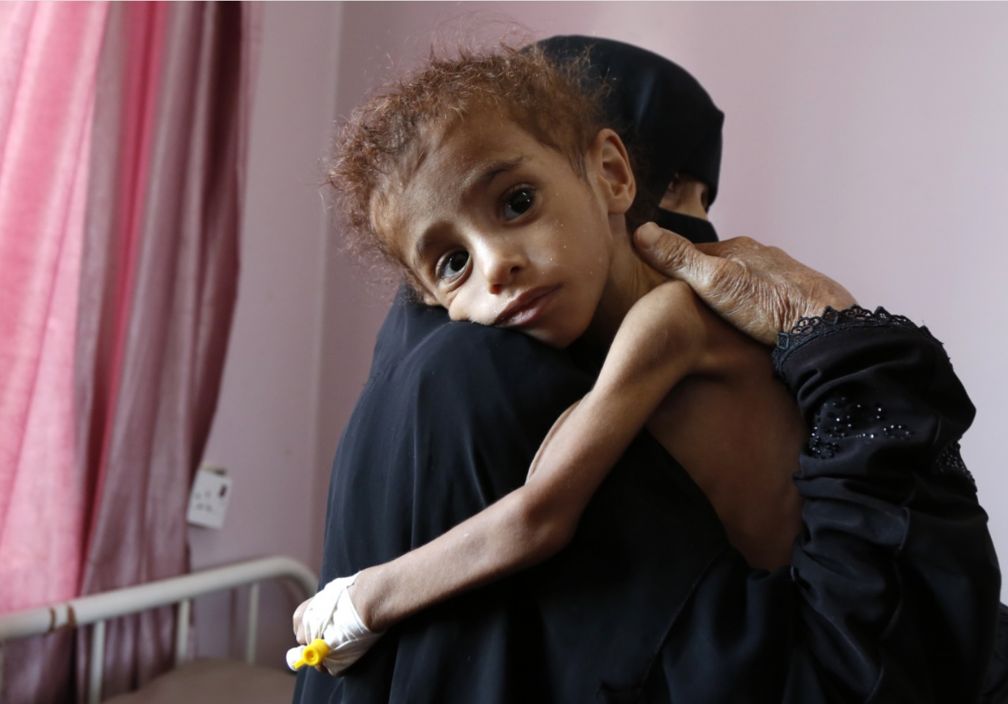
Yemen
> 85,000 children dead
Ongoing blockade led by Saudi Arabia
Notes:
Nearly four years since the brutal conflict in Yemen escalated, 14 million people are at risk of famine. That number has increased dramatically since the Saudi-led coalition imposed a blockade on Yemen in November 2017. We are horrified that as many as 85,000 children may have died because of extreme hunger since the war began. For every child killed by bombs and bullets, dozens are starving to death—and it’s entirely preventable.
Australia supplies military exports to both Saudi Arabia and UAE
Plans to expand this arms trade.
Dozens of Saudi Arabia-led Coalition airstrikes have disproportionately and indiscriminately killed civilians, including children, and targeted hospitals, school buses and markets.

Slide 15
Arms embargo?
Germany, Norway, Finland, Netherlands, Denmark and Belgium cut off arms supplies to Saudi because of major human rights violations in Yemen.
UK, US resolutions condemning sales
Notes:
Supplying arms to countries that are killing civilians, including children, is simply indefensible. in conducting airstrikes by ensuring that civilians and civilian objects are not targeted.
Uk house of lords UNLAWFUL US condemnation
In December, the US Senate voted to withdraw military aid for Saudi Arabia’s war in Yemen. It was thought unlikely that the House of Representatives would follow suit, but following the change to a Democratic majority, the House passed such a resolution by 248 to 177 votes.
UK House of Lords’ International Relations Committee unanimously reported that the government is breaking the law by issuing export licenses and selling munitions to Saudi Arabia that “are highly likely to be the cause of significant civilian casualties in Yemen”. High court appeal to come
Killing of Jamal Khashoggi illustrated globally the ruthlessness of the Saudi govt
US started more wars than any othe rcountry since 1945
US spend now $650 Billion gone up $100 billion under Trump- more than next 7 countries put together(almost as much as 8) (China, Saudi, India, France, Russia, Britain,Germany, Japan) = 60 % of discretionary budget (= once interets and entitle ment payments like pensions dedcuted)

Slide 16
Spending priorities
US pushing Allies -spend 2% of GDP on defence
Taxation = less than a quarter of GDP
Government budget 2019-20 = $506 billion
Defence budget 2019-20 $37.4 Billion = 7.4%
2025-26 $ 59 Billion
The Australia Institute calculations based on Australian Government, 'Statement 5: Expenses and net capital investment', Budget Strategy and Outlook: Budget Paper No 1, 2019-20. https://www.budget.gov.au/2019-20/content/bp1/download/bp1_bs5.pdf pages 5-7, 5-47.
Notes:
Australia 4th highest weapons importer in the 2018 year
Risk of starting regionall arms race

Slide 17
Australia’s defence budget
Defence budget
Decoupled from cuts in every other part of the budget
2018 year to $38.1 Billion
Australia globally fourth biggest weapons importer
Notes:
Each “smart” bomb we drop is worth between A$70,000 – A$650,000.
Future Submarines Program (FSP) aims to build 12 submarines at a cost of what could be more than $36 billion (up to 50 billion), taking the Australian Strategic Policy Institute's estimate of each sub costing up to $3.04 billion
First will be commissioned 2030s , last of them late 2040s still operating in 2070 ???

Slide 18
Australian Military Spending
Notes:
Risk of a regioanl arms race, Oz 4th largest weapons importer

Slide 19
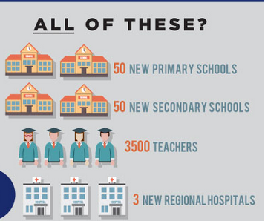
$ 5 Billion buys:
The Australia Institute February 2019

Slide 20
Plus these
The Australia Institute February 2019

Slide 21
Foreign Aid
Shameful levels currently
Shameful use of aid
Impacts of reduced aid
Benefits of constructive use of aid
Notes:
Unicef has said cuts in Australian aid mean that a hugely successful program in Africa, helping 750,000 people access water, sanitation and vaccination, is now off the table.
Gordaon Brown in midst of Uk austerity- we will not make cuts on the back of the world’s poorest 0.7% legislated in perpetuity
cf 0.21% GNI

Slide 22
Foreign Aid
Notes:
UK 0.7% GNI legislated (OECD target) even while austerity elsewhere- not cutting funding for the world's poorest cf Tony Abbott cuts to fund Oz Infrastructure
Paris $1 billion over next 5 years is to come from existing foreign aid budget
In 2014 Australian Treasurer Joe Hockey said that savings of $3.7 billion in the foreign aid program over the next four years would offset new commitments in Defence and national security.
Oz 0.21% aid vs aim for 2% defence

Slide 23
Notes:
Stockholm international peace research institute
21% eradicates extreme poverty and hunger , provides basic health care vaccinations and clean water and sanitation,
33% includes in basic education globally as well.

Slide 24
Militarisation of public service
Customs and immigration now paramilitary “Border Force”
Language of invasion and threat to borders
Secrecy and military operational language:
-Less transparency
-Less accountability
Notes:
Complete with uniforms
TV footage o Scott Morrison at Christmas Island- Border force and ADF personnel- ramps up image of invasion Cost $140 million
Not people fleeing war and persecution, but invasion and threat.

Slide 25
Damage to democracy
Opaque donations via third party entities- distorts who get elected
Opaque spending
Untendered contracts April 1- May 18 2019
$50 Billion total*
$42 billion in defence:
Lockheed Martin, Boeing, Thales, Rheinmetall
*Data Expert Greg Bean – Analysis of AusTender Data. Saturday Paper May 25th 2019
Notes:
Donations extremely weak disclosure laws
More than half never reported by source
Delayed- >$100 million in the 2016 election
Tax cuts 2nd and third triple cost of newstart $75 a week raise

Slide 26
Revolving door
Senior defence force officials
Senior public servants
Senior politicians
Well paid board positions
Undue influence?
Notes:
Ex Defence ministers Kim Beasley, Brendan Nelson
Chair Commander Navy air fleet arm
Secretary dept Defence Secretary dept Vet affairs
Significant contacts and influence on governments

Slide 27
Impacts of too close relationships
Size of spend on military
Appropriate choices- type, value
Risk of regional arms race
Australian society as a whole

Slide 28
Poverty in Australia 2018
Over 3 million living below poverty line including 739,000 children.
Most in deep poverty,$135 per week below the poverty line.
Highest rates are those on Govt allowances – Youth Allowance (64%)
Newstart (55%).
ACCOSS and UNSW Poverty in Australia 2018 https://www.google.com/search?client=firefox-b-d&q=acoss+poverty
Notes:
17% of all children were living in households experiencing poverty, (26% when 60% poverty line is used).
In sole parent families 39% (52% respectively).
The risk of poverty for children in sole parent families is three times that for children in couple families

Slide 29
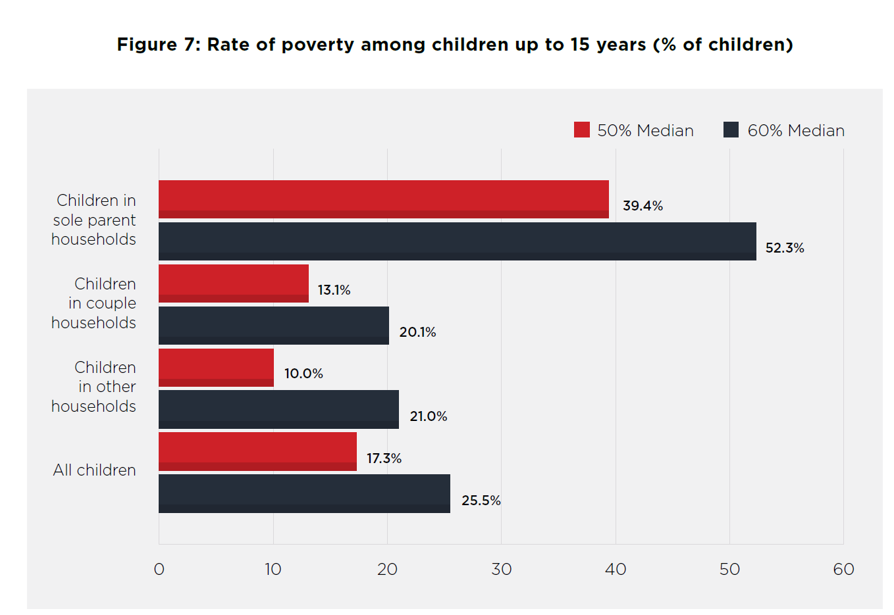
ACCOSS and UNSW Poverty in Australia 2018 https://www.google.com/search?client=firefox-b-d&q=acoss+poverty
Notes:
sole parent families have the highest poverty rates at 32%.
While the full-time minimum wage sits above the poverty line for a single adult without
children, this does not prevent wage-earning families with children, those with only
part-time earnings, and those with high housing costs, from falling into poverty. Among
people in households whose main income is wages, 7% are in poverty. Since most people
live in wage-earning households, this group forms a substantial proportion (38%) of all
people in poverty.
The transfer of 80,000 sole parents to Newstart Allowance in 2013 was associated with
an increase in the rate of poverty among unemployed sole parents from 35% in 2013 to
59% two years later.
ACOSS

Slide 30
The myth of Legal Aid
Just 8% of those under poverty line can access
Most impoverished people are considered too wealthy to get basic legal help.
Legal issues compound other social/economic challenges creating a dire situation.
http://legalaidmatters.org.au/ 2019 Law Council of Australia
Notes:
In 1997, the Federal Government spent $11.22 per capita on legal aid. Today, we are heading toward less than $8 per capita. The Federal Government has also passed more and more of the burden to the States. It was mak
ing 55 per cent of the contribution until 1997, and today it only contributes 35 per cent of funds.
People often experience complex and multiple levels of disadvantage.
LAW COUCIL OF OZ
Hundreds of millions of dollars in cuts by successive Federal Governments have pushed legal aid to the brink of collapse.
Legal aid services are closing.
More cuts are on the way.

Slide 31
Social housing
25 years of inadequate investment
shortfall of 433,000 social housing dwellings.
Current construction– just over 3,000 dwellings a year – does not even keep pace with rising need
Direct public investment, coupled with more efficient financing is the best way to address this.
Australia needs to triple its social housing by 2036. This is the best way to do it. The Conversation. Nov 2018
https://theconversation.com/australia-needs-to-triple-its-social-housing-by-2036-this-is-the-best-way-to-do-it-105960
Notes:
From 1996, however, social housing largely slipped from the Australian government agenda. Dedicated ongoing funding to states and territories was at “starvation levels”. Public house building plunged to today’s residual output, except for a short-lived GFC-stimulus-funded recovery from 2008-11.

Slide 32
116,000 homeless people
2016 census
Simply preventing the existing problem from getting worse =15,000 extra dwellings a year
To eliminate the backlog 36,000 units a year
Cost (first year of the program) is A$5 billion.
Australia needs to triple its social housing by 2036. This is the best way to do it. The Conversation. Nov 2018
https://theconversation.com/australia-needs-to-triple-its-social-housing-by-2036-this-is-the-best-way-to-do-it-105960
Notes:
This would need to begin gradually to build capacity and avoid inflating costs.
The required increase in social housing construction sounds huge, but it’s a rate Australia managed in the past and is lower than in many other countries. Joel Carrett/AAP This would represent around a tenfold increase in current social housing construction rates.
We calculate that the cost of the first year of the program would total A$5 billion under a capital grant approach. A private debt-financed approach, with government support through revenue subsidies, would cost A$6.6 billion.

Slide 33
Alternative
Focus on Australia’s national interest
Recognise :
Ramping up defence spending:
damages other strategic priorities,
risks a regional arms race
Indirect costs:
electoral
health, education, housing, legal aid etc.
Notes:
Change from Warjoiners to peac3e makers- Bouganville Cambodia the Solomnons we made a positive contribution to peace

Slide 34
So what can we do?
Effective ICAC
Public funding of elections
Political donation reform
Regulate lobbyists (and jobs post career for MPs and others )
Notes:
Guardian Transparency project
New centre for public integrity Former lawyers judges and integ=rity experts
Heade up by Anthony Whealy (ex NSW Court of appeal)
‘Tony Fitzgerald, David Ipp, Stephen Charles
“Ample evidence of the power of money in our political system. Curently no agency that can effectively investigate corruptionallegations in federal politics and public service. A national integrity commmission with strong powers and ability to hold public hearings is crucial to public trust.”

Slide 35
Contact MPs
Australia to stop selling weapons to Saudi Arabia and UAE
Halt massive increase in defence spending and increase diplomacy and foreign aid budgets
Stop subsidising weapons companies
Limit donations to public institutions
Notes:
Eisenhower 1961

Slide 36
Divestment
Contact your super fund
Ask re all portfolios and ethical portfolios
“Quit Nukes”
Good choices: Australian Ethical, Future Super
Contact your bank- ask why
Good choices: Bendigo Bank, Bank Australia

Slide 37
Working for a more peaceful world
www.icanw.org.au
www.mapw.org.au
FB MAPW student group
FB Medical Association for Prevention of War
T @MAPW_Australia

Slide 38
Militarism Impacts
Community
Government
Electoral Process
Australia’s ability to defend itself
Rising inequality

Slide 39
“We must guard against the acquisition of unwarranted influence, whether sought or unsought, by the military-industrial complex.
The potential for the disastrous rise of misplaced power exists and will persist."
Dwight Eisenhower 1961
Notes:
Honesty once leaving politics.

