Slide 1
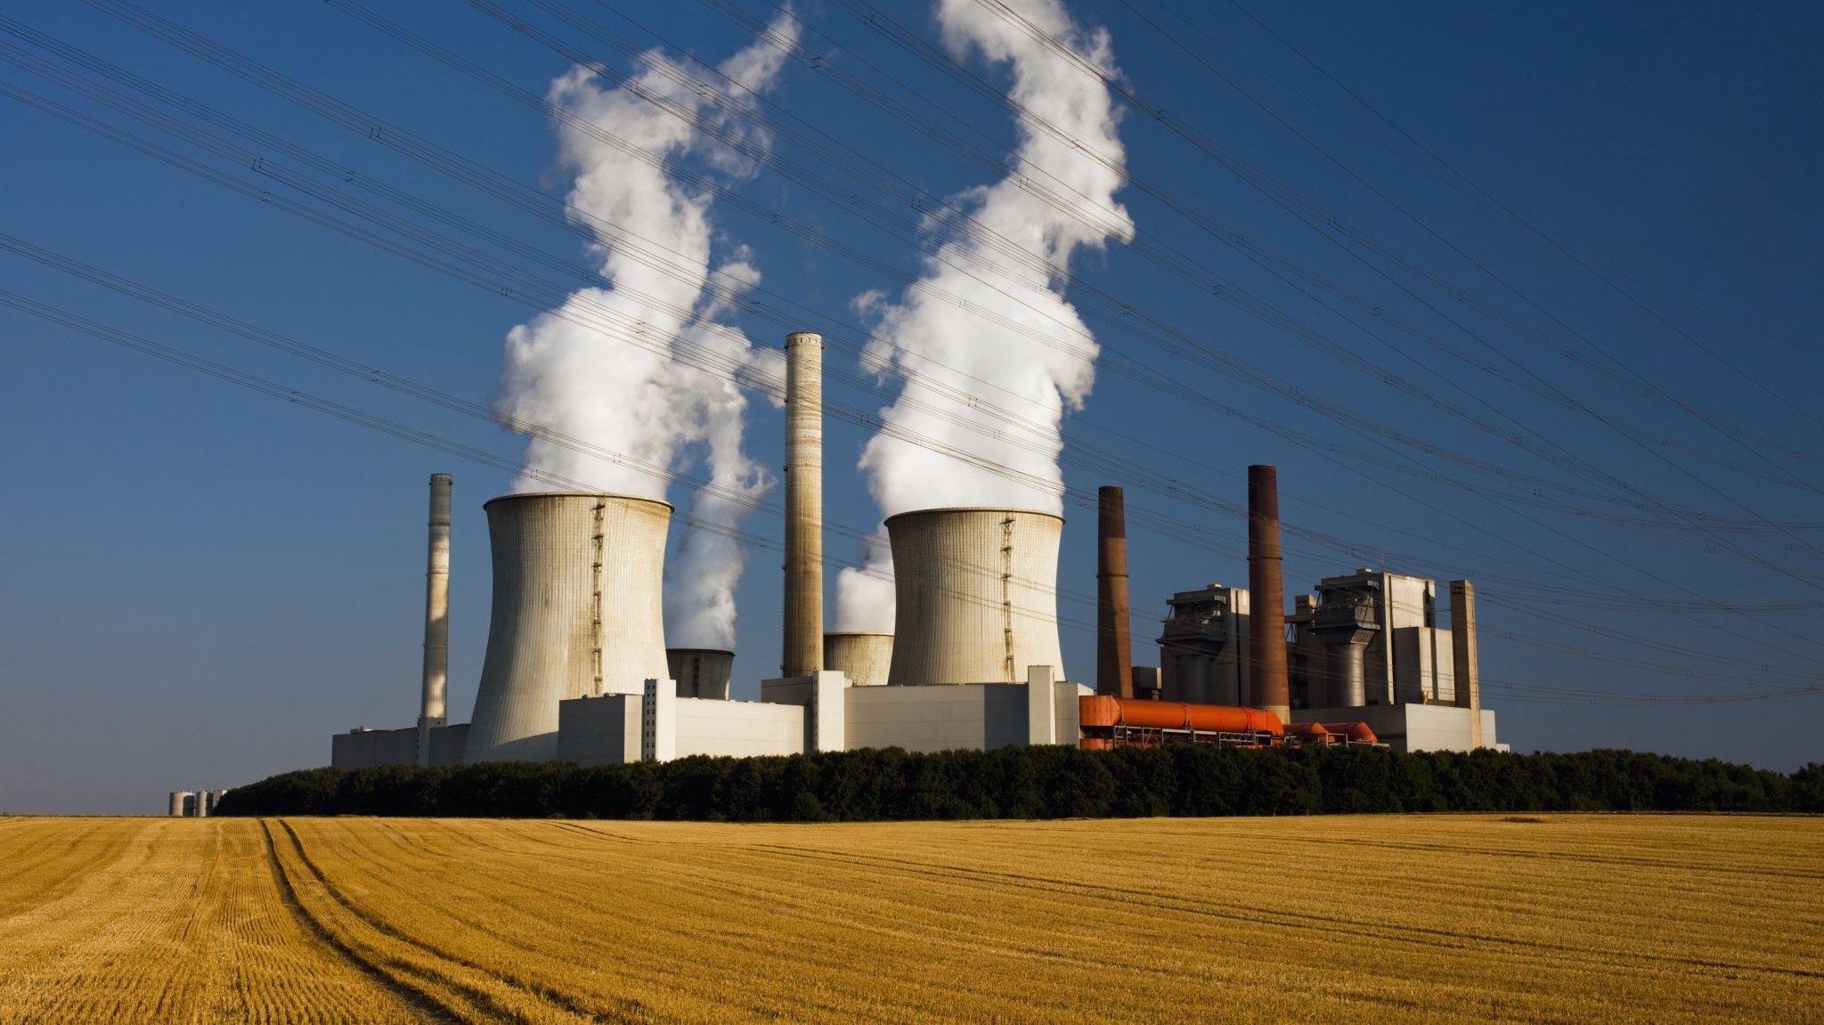
Nuclear power:
Community health, safety and security.

Slide 2

Dr Margaret Beavis OAM
Notes:
Nuclear chain- reactors and weapon
Climate impacts – more forced displacements, refugees, conflicts

Slide 3
Workers
Communities
Australia
Globally
An evidence-based approach
Thanks to A/Prof Tilman Ruff and Dr Jim Green

Slide 4
Radiation impacts
Cancer is common and radiation has no “signature” cancer, so it’s hard to tell which cancers come from radiation
Cancers blend in - Don’t look, don’t find
Worse for women and much worse for children
Background radiation Australia 1.7 mSv/year
Medical radiation
Notes:
The cancers caused by radiation blend in with other cancers – they are not like the characteristic mesothelioma caused by asbestos. The heart attacks and strokes have the same problem. As a result, it takes large population studies and careful long-term monitoring to know what the risks are.
Four times worse for babies than adults
The Average global background level of radiation, is about 2.4 msv per year. A single back-to-front chest X-ray typically involves a dose of 0.01 mSv; a CT scan typically involves doses of 3–12 mSv or more. Acute exposures over 100 mSv produce effects on chromosomes measurable by laboratory testing. Doses below 100 mSv are generally categorized as ‘low dose’.

Slide 5
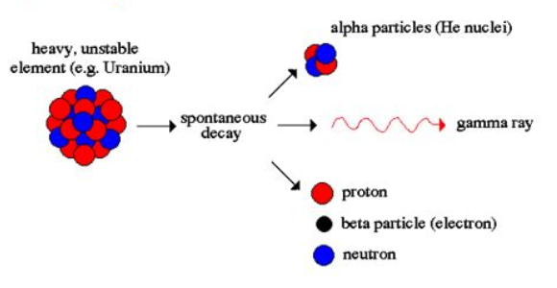
So what is radioactivity?
Notes:
Radioactivitivity is from bit sthat are given off by a radioactive (unstable) element
Ionising radiation can be produced by the spontaneous decay of RADIOACTIVE ELEMENTS WHICH FRAGMENT INTO SMALLER ATOMS, OFTEN REPEATEDLY. At each step, energy is usually also released in the form of ionising radiation. These decay chains often have intermediaries which are also radioactive, until they eventually end up as stable elements. The decay chain, the rate at which each step occurs, and the type of radiation emitted are fixed physical properties of each radioactive element. The rate of radioactive decay is described by the half-life – the time it takes for half the amount of a radioactive element to disintegrate

Slide 6
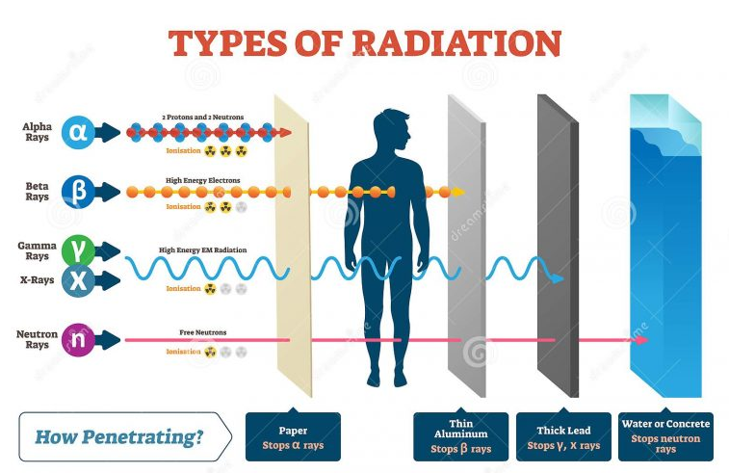

Slide 7
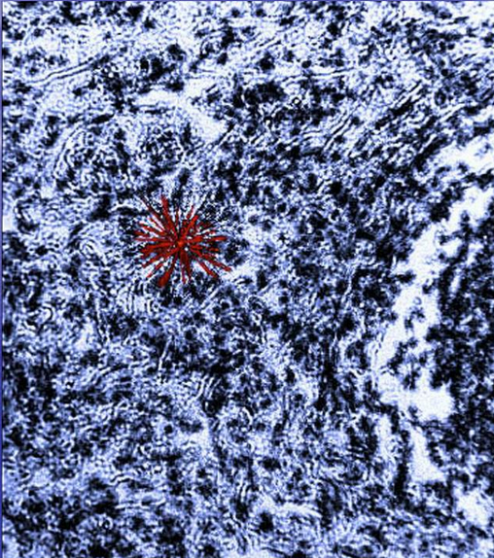
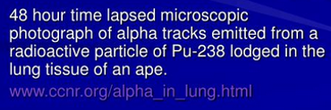
Alpha Particle in lung
DNA Damage: may lead to mutations and, in severe cases, the initiation of cancer.
Cellular Death
Inflammatory Responses: Amplifies damage and risk of health complications.

Slide 8
Cancer risk varies by age and gender
Overall females 40% more sensitive to cancer risk
NAIIC report; data from BEIR VII, US NAS 2006
Notes:
Radiation risks differ. Young children are approximately 4 times more sensitive to the cancer inducing effects of any given dose of radiation than are adults.
Women and girls are overall about 40% more sensitive than males.

Slide 9
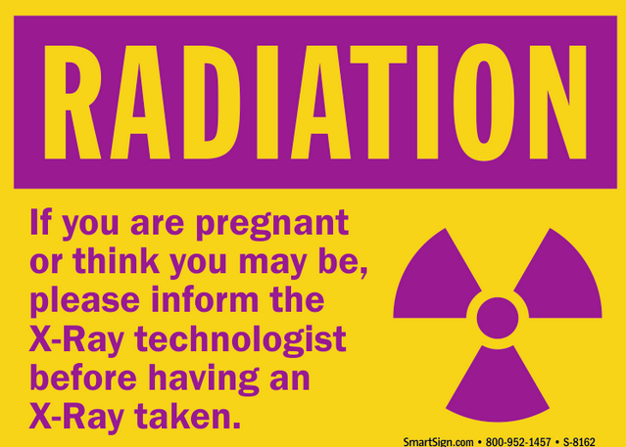

Slide 10
US National Academy of Sciences.
BEIR VII in 2006 stated
“the risk of cancer proceeds in a linear fashion at lower doses without a threshold and that the smallest dose has the potential to cause a small increase in risk to human”’
In other words, there is no exposure to ionising radiation that is risk-free.
https://nap.nationalacademies.org/resource/11340/beir_vii_final.pdf

Slide 11
“Low dose radiation is harmless”
This is at odds with expert opinion from:
2006 The US National Academy of Sciences' Committee on the Biological Effects of Ionising Radiation (BEIR)
2010 The United Nations Scientific Committee on the Effects of Atomic Radiation (UNSCEAR) in
2021 The US Nuclear Regulatory Commission (NRC)
The National Council on Radiation Protection and Measurements,
International Commission on Radiological Protection
The International Atomic Energy Agency
Three US federal agencies ‒ the National Cancer Institute, the National Institute for Occupational Safety and Health, and the EPA’s Radiation Protection Division
So just about everybody credible in the nuclear radiation space
Combined Environment Groups Submission to the Senate Environment and Communications Legislation, Committee Inquiry into the Environment and Other Legislation Amendment (Removing Nuclear Energy Prohibitions) Bill 2022. Page 83 https://nuclear.foe.org.au/wp-content/uploads/Combined-Environmental-NGOs-submission.pdf

Slide 12
Workers
INWORKS study:
309 932 radiation-monitored workers followed for an average 35 years
to average age 70 yo
87% male (least susceptible group) 13% female.
Leukaemia, lymphoma, and multiple myeloma mortality after low-level exposure to ionising radiation in nuclear workers (INWORKS): updated findings from an international cohort study - The Lancet Haematology October 2024
Cancer mortality after low dose exposure to ionising radiation in workers in France, the United Kingdom, and the United States (INWORKS): cohort study https://doi.org/10.1136/bmj-2022-074520
Ionising radiation and cardiovascular disease: systematic review and meta-analysis https://www.bmj.com/content/380/bmj-2022-072924
Notes:
The best scientific information comes from ongoing long-term studies of workers in nuclear industries. For workers in the nuclear industries, there is also clear evidence of increased risk of death from cancer. Indeed, recent findings show even some non-cancer diseases are increased, such as heart attack and stroke.
Follow ups from 1944 to 2016
The best evidence for this comes from INWORKS, a multi-country study of over 300,000 radiation industry workers observed for more than 30 years. Their radiation exposures and health outcomes were carefully monitored and compared with the general population.

Slide 13
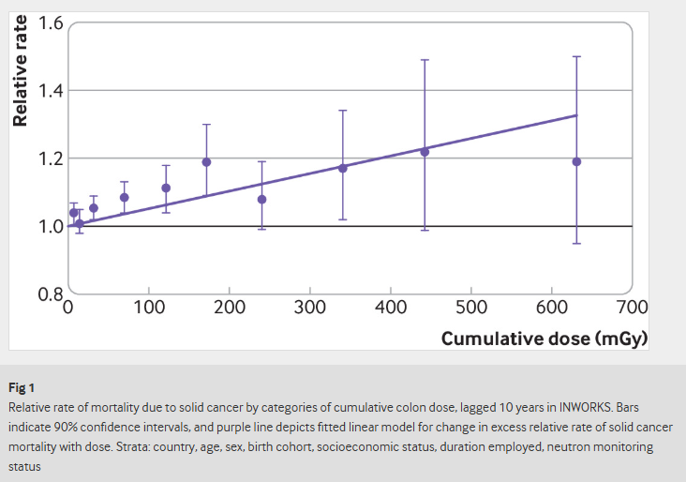
Excess deaths vs radiation exposure
Majority of workers exposed to less than 100 mGy (blue arrow)
Risk of cancer increases with increased exposure
No safe minimum dose
Heart attacks and strokes at similar rate
Cancer mortality after low dose exposure to ionising radiation in workers in France, the United Kingdom, and the United States (INWORKS): cohort study BMJ August 2023 https://www.bmj.com/content/382/bmj-2022-074520

Slide 14
Communities
CHILDHOOD LEUKEMIA - concern and controversy for decades
1980s leukaemia and lymphoma in children around the Sellafield nuclear plant in England. Confirmed by UK government investigation
1980-2006 UK National Registry of Childhood Tumours Risk of a child developing leukaemia increased by 12% for every additional mSv
2007 meta-analysis US Department of Energy examined all of the reliable data available worldwide. Confirmed a statistically significant increase in leukaemia for children living near nuclear power plants.
Gardner MJ, Snee MP, Hall AJ, Powell CA, Downes S, Terrell JD. Results of case-control study of leukaemia and lymphoma among young people near Sellafield nuclear plant in West Cumbria. British Medical Journal. 1990;300(6722):423-429. https://doi.org/10.1136/bmj.300.6722.423
G. M. Kendall, M. P. Little, R. Wakeford, K. J. Bunch, J. C. H. Miles, T. J. Vincent, J. R. Meara, M. F. G. Murphy, ‘A record-based case–control study of natural background radiation and the incidence of childhood leukaemia and other cancers in Great Britain during 1980–2006’, Leukemia, Vol. 27 (2013), 3–9.
P. J. Baker and D. G. Hoel, ‘Meta analysis of standardised incidence and mortality rates of childhood leukaemia in proximity to nuclear facilities’, European Journal of Cancer Care, Vol. 16 (2007), 355–63.
Notes:
In the 1980s excess cases of leukaemia and lymphoma were noticed around the Sellafield nuclear plant in England
2024 > 7 million people Residents living within 30 km of the nuclear power plants had a 5% increased all-cancer risk compared with that of those living farther than 30 km, when the incidence and mortality outcomes were separated By cancer type, we found significantly increased risks for thyroid cancer by 17% and leukemia by 9% Worse in children under 5.

Slide 15
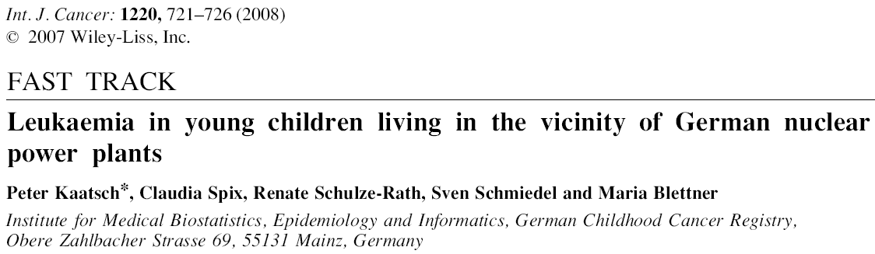
German Childhood Cancer Registry data (less than 5yo) 1980 – 2003
Matched case-control study with 593 leukemia cases
Rates of leukemia more than double (2.19 times) if living within 5 km of nuclear reactor

Slide 16
Childhood leukemia and nuclear power plants

Slide 17
2024 Study – another very large meta-analysis
7 million people
Living within 30 km of the nuclear power plants had a 5% increased all-cancer risk
Significantly increased risks for thyroid cancer by 17% and leukemia by 9%
Worse in children under 5.
Lin, RT., Boonhat, H., Lin, YY. et al. Health Effects of Occupational and Environmental Exposures to Nuclear Power Plants: A Meta-Analysis and Meta-Regression. Curr Envir Health Rpt 11, 329–339 (2024). https://doi.org/10.1007/s40572-024-00453-8

Slide 18
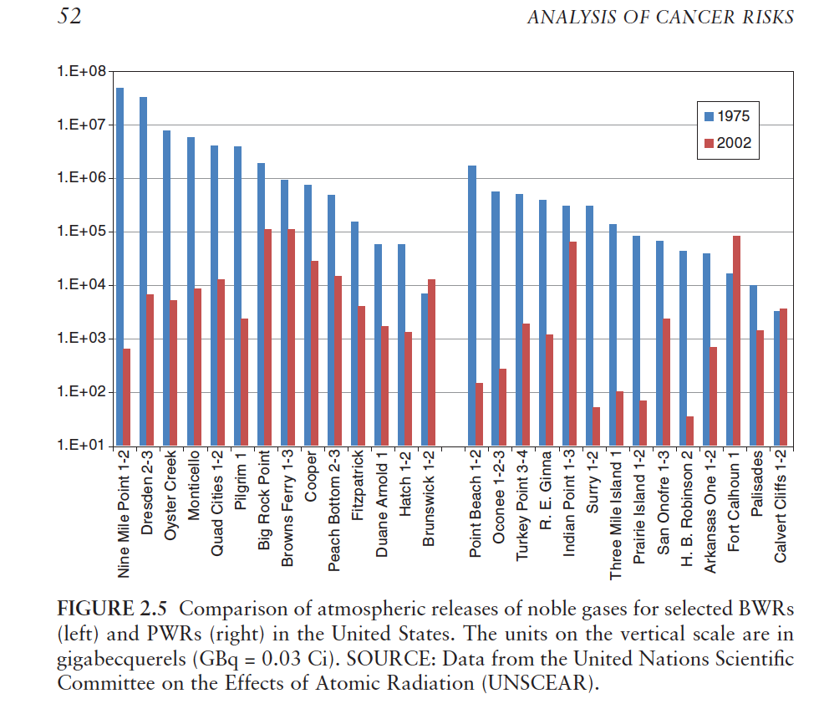
Radioisotopes released as a part of normal operations
Boiled water reactors – left
Pressurised water reactors – right
Blue 1975
Red 2002
Burris, J.E.,…, T. Mousseau, et. al. 2012. Analysis of Cancer Risks in Populations Near Nuclear Facilities: Phase I. Nuclear and Radiation Studies Board, The National Academies Press, Washington, D.C., 412pp.
Notes:
Burris, J.E.,…, T. Mousseau, et. al. 2012. Analysis of Cancer Risks in Populations Near Nuclear Facilities: Phase I. Nuclear and Radiation Studies Board, The National Academies Press, Washington, D.C., 412pp

Slide 19
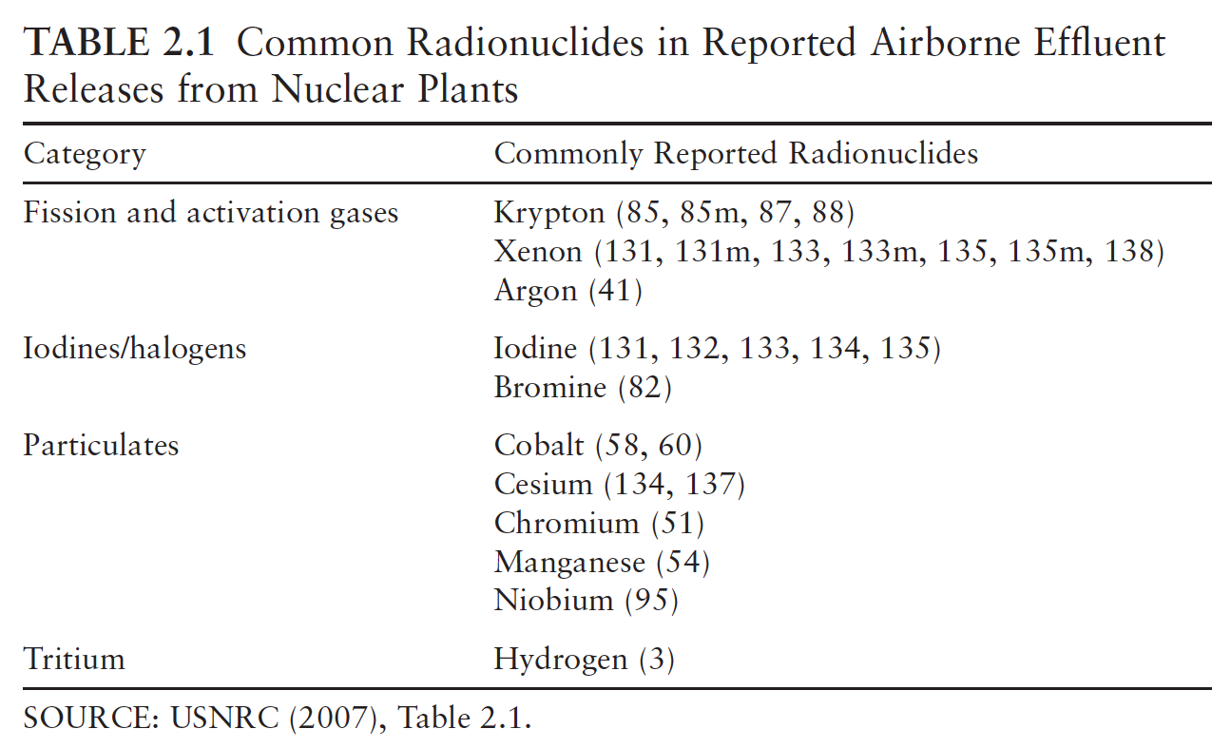

Slide 20
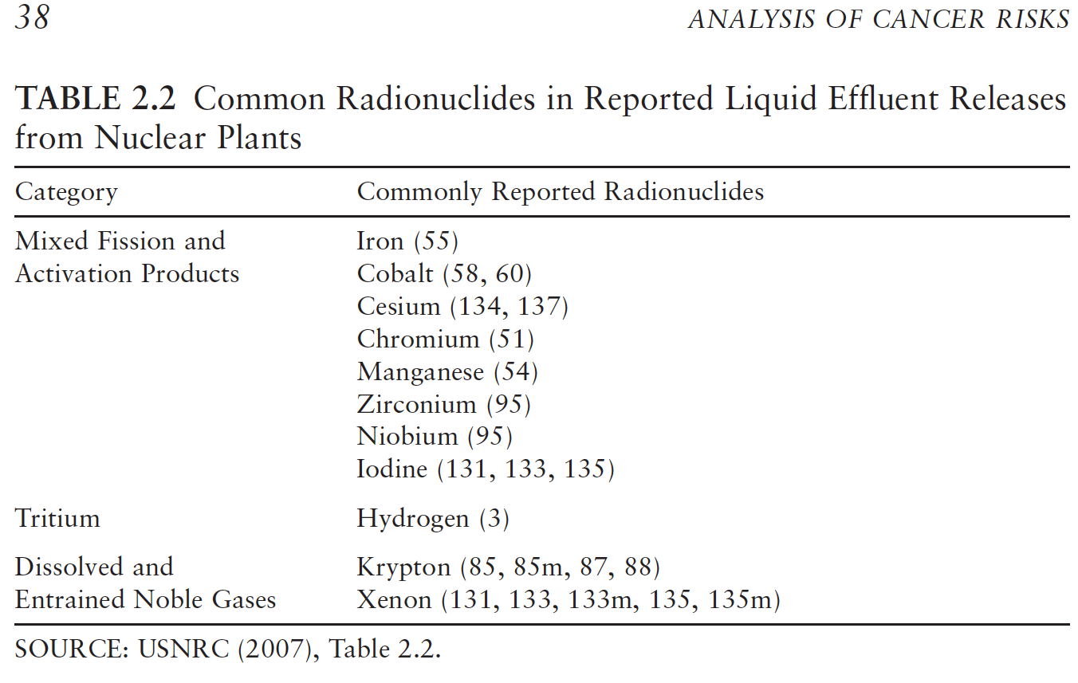

Slide 21
Accidents and attacks
No commercial insurance
For catastrophic reactor accidents
For households
Why?

Slide 22
Accidents
Complex systems fail at some point
Nuclear reactors have the potential for radioactive releases that are enormous in size and last for years.
Best known: Windscale, Chernobyl, Three Mile Island and Fukushima
There have been at least fifteen accidents involving fuel or reactor core damage, with substantial risk of uncontrolled radioactive release, in Canada, Germany, Japan, Slovakia, the United Kingdom, Ukraine and the United States.
Combined Environment Groups Submission to the Senate Environment and Communications Legislation, Committee Inquiry into the Environment and Other Legislation Amendment (Removing Nuclear Energy Prohibitions) Bill 2022. Page 83 https://nuclear.foe.org.au/wp-content/uploads/Combined-Environmental-NGOs-submission.pdf

Slide 23
So how often do accidents happen?
2017 analysis of 216 events between 1950 and 2014 that threated safety or damaged human health or property.
Suggested:
One event per year worldwide
50% chance of a Fukushima magnitude (or greater) event happening within 62 years
Wheatley S, Sovacool B, Sornette D. Of Disasters and Dragon Kings: A Statistical Analysis of Nuclear Power Incidents and Accidents. Risk Analysis. January 2017;37(1):99-115. https://doi.org/10.1111/risa.12587

Slide 24
Nuclear reactor core meltdown/INES 4 accidents
(INES 4 = high probability of significant public exposure)
Total of 20+ including Fukushima Daiichi 1-3
13 power reactors, multiple types
All now permanently shut down
Core melt accidents: 1 in 1300 reactor years
Many near-misses
    Burns, Ewing and Navrotsky, Science, 2012
    Brice Smith, Insurmountable risks IEER 2006
    Thomas Cochran, NRDC US Senate testimony 12.4.11

Slide 25
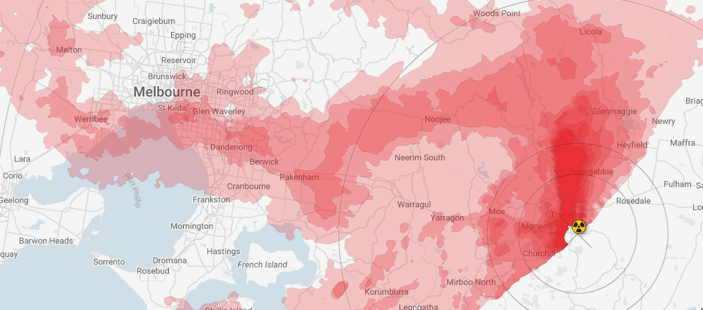
Accident fall out nuclearplume.au

Slide 26
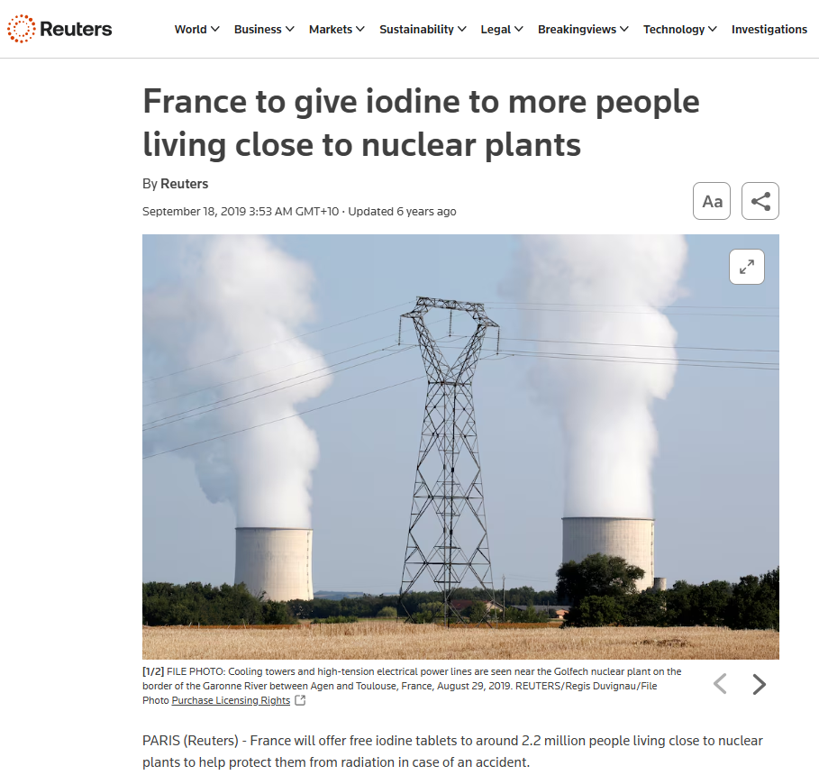

Slide 27
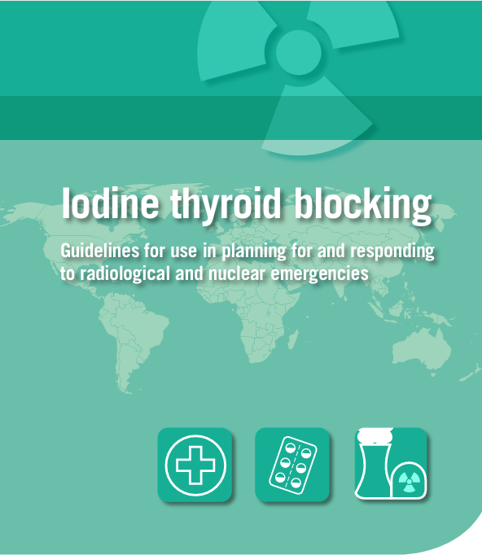

Will Traralgon, Morwell, Rosedale and surrounding areas be given Iodine tablets?
How will everyone be notified?
Will you know about an accident - in time?

Slide 28
Reactors are vulnerable to climate change risks
Shut-downs with heatwaves, droughts
Fires
Floods
“In the last decade (2010-2019), the frequency of climate-related nuclear plant outages was already nearly eight times higher than in the 1990s”
Beware statements that “new reactors are safer”
That’s what they always say about new reactors… and not true.
Not proven until decades of operation.
Nuclear is not the solution: the folly of atomic power in the age of climate change, by M. V. Ramana, London, Verso, 2024,

Slide 29
Misleading claims
Repeated claims linking radiology, radiotherapy and nuclear medicine to nuclear power:
“Nuclear energy already plays a major role in medicine and healthcare, diagnosing and treating thousands of Australians every day”.
Nuclear medicine has nothing to do with getting nuclear power
Notes:
The Coalition has also made claims linking radiology, radiotherapy and nuclear medicine to nuclear power that are patently false and deliberately misleading.
A letter sent by Coalition MPs to their constituents earlier this year claimed that: “Nuclear energy already plays a major role in medicine and healthcare, diagnosing and treating thousands of Australians every day”.
We do not have, and have never had, nuclear power in Australia, and the nuclear power proposal has no connection to our world class nuclear medicine, radiology or radiotherapy services.

Slide 30
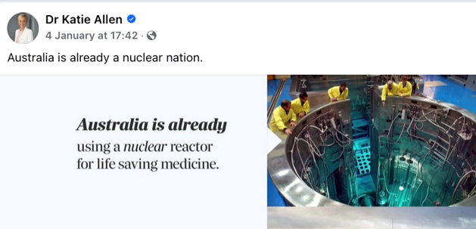
False claims about nuclear power

Slide 31
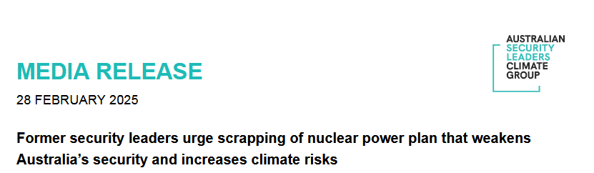
Attacks
The Australian Security Leaders Climate Group
“Australia should not proceed with the proposed plan for nuclear power stations due to the climate and security consequences they pose to the nation”

Slide 32
Admiral Chris Barrie- former head of Australian Defence Force
Every nuclear power facility is a potential dirty bomb because rupture of the containment facilities can cause devastating damage.”
“Modern warfare is increasingly focused on missiles and uncrewed arial systems (drones) and with the proposed power stations all located within 100 km of the coast, they are a clear and accessible target.”
Prolong coal and gas “Derail our climate targets”

Slide 33
Vulnerable in peace as well
1983- 2007 There were 10 security incidents regarding Lucas Heights
With more sophisticated technologies, attacks by terrorists or criminals get easier, with AI, cyberattack, missiles and drones.

Slide 34
Internationally
Weapons proliferation
PM John Gorton thought nuclear power could enable Australia to get weapons later
Enormous cost raises questions from our neighbours and potentially starts a “race”
Climate change
Increased forced displacements
Increased conflicts
Notes:
“Arms race” Indeed Prime Minister John Gorton admitted “We were interested in this thing because it could provide electricity to everybody and it could, if you decided later on, it could make an atomic bomb.”
Pilita Clark, ‘PM’s Story: Very Much Alive…and Unfazed’, The Sydney Morning Herald, 1 January 1999.

Slide 35
Nuclear Waste
Nobody wants this highly toxic stuff
Needs isolation for 10,000- 100,000 years
(Pharaohs were only 5,000 years ago)
Potential for health impacts for many many future generations
Divides communities – major and lasting social and mental health issues
First Nations communities repeatedly targeted.
Weapons testing a national disgrace.

Slide 36
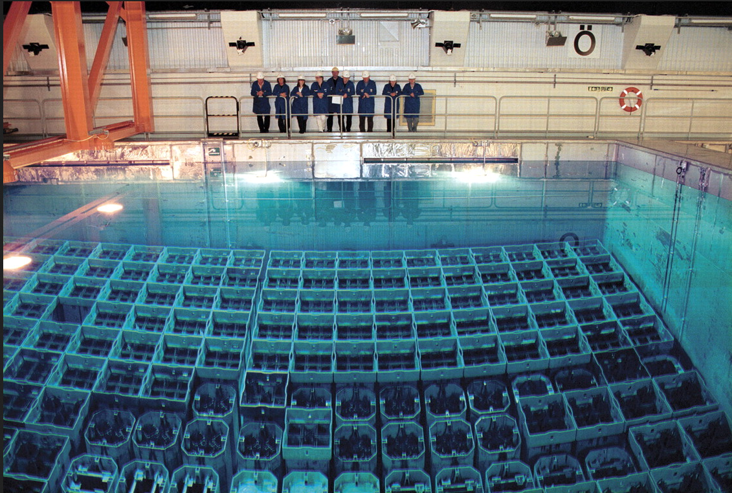
Spent fuel cooling pool- on site of reactor

Slide 37
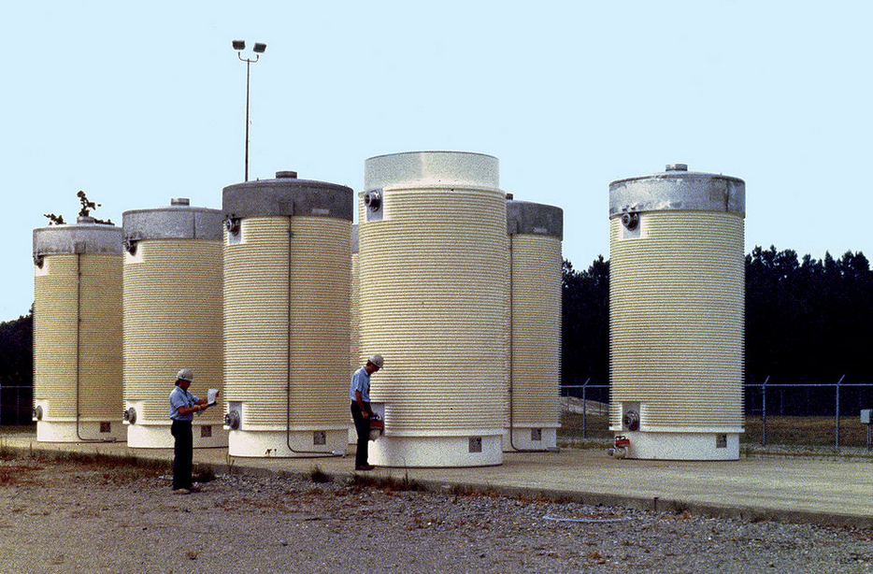
Canisters- usually also on site of reactor

Slide 38
International waste dump?
The policy buttresses claims that Australia should become a site for the large quantities of radioactive nuclear waste generated by other countries.
For decades, there have been calls for Australia’s outback to be the site for disposal of the world’s radioactive waste.

Slide 39
For Communities
radiation impacts have significant health implications for workers and populations living near its facilities, including increased rates of childhood leukemia
reactors are vulnerable to catastrophic accidents and attack,
requires huge amounts of our most precious resource - water,

Slide 40
But wait - there’s more
is inextricably associated with producing the world’s worst weapons,
generates significant emissions in many stages of its operation,
produces dangerous waste for which there is still no solution,
is very expensive,
worsens climate change
is unnecessary, given the rapid expansion of firmed renewable energy sources.

Slide 41
In Summary
Nuclear power plants have clear health risks for workers and communities.
In addition, nationally, there will be significant health issues from worsening heat waves, bushfires, storms, floods and droughts.

Slide 42
Questions?

