Slide 1
The Environmental Impacts of Australian-US Military Cooperation on the NT
Shar Molloy
Director, Environment Centre NT
Notes:
Acknowledge Larrakia
Thank for the opportunity
ECNT – 1983 – Peak body – Campaigns such as Jabiluka, Mukaty Nuclear Waste Dump
Overview of facilities, impacts and build up – Glyde point

Slide 2
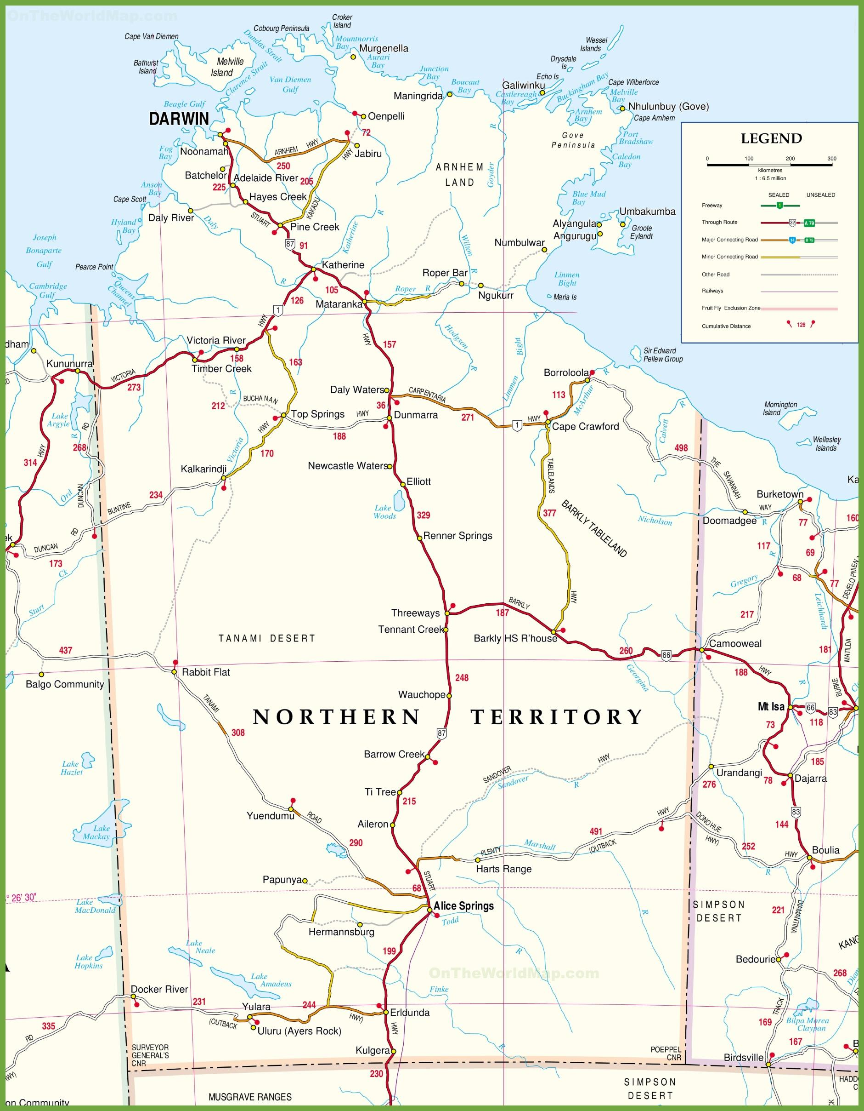
Major Military Installations in the NT
Two air force bases:
RAAF Darwin and RAAF Tindal
Two army barracks:
Larrakeyah and Robertson
One naval base:
HMAS Coonawarra
Four onshore training areas:
Delamere Air Weapons Range,
Bradshaw, Kangaroo Flats,
Mt Bundey
One joint US/Australian signals installation: Pine Gap
Other Sites of Interest
One former mine that supplied uranium for the UK and US nuclear weapons program:
Rum Jungle
One proposed deep water port to accommodate the US Navy: Glyde Point
Notes:
Even before the joint force posture initiative, the Australian military had a prominent footprint in the NT, with a particular concentration of military installations in and around Darwin.
In the Darwin region, there is RAAF Darwin, Larrakeyah and Robertson Barracks and HMAS Coonawarra. Kangaroo Flats and Mt Bundey training areas are relatively closeby.
Further afield, there is RAAF Tindal near Katherine, Delamere Air Weapons Range, and Bradshaw Field Training Area.
The Northern Territory also has a long history of bearing the environmental impacts of US-Australian military cooperation, as shown by two more sites on this map: Pine Gap and Rum Jungle.

Slide 3
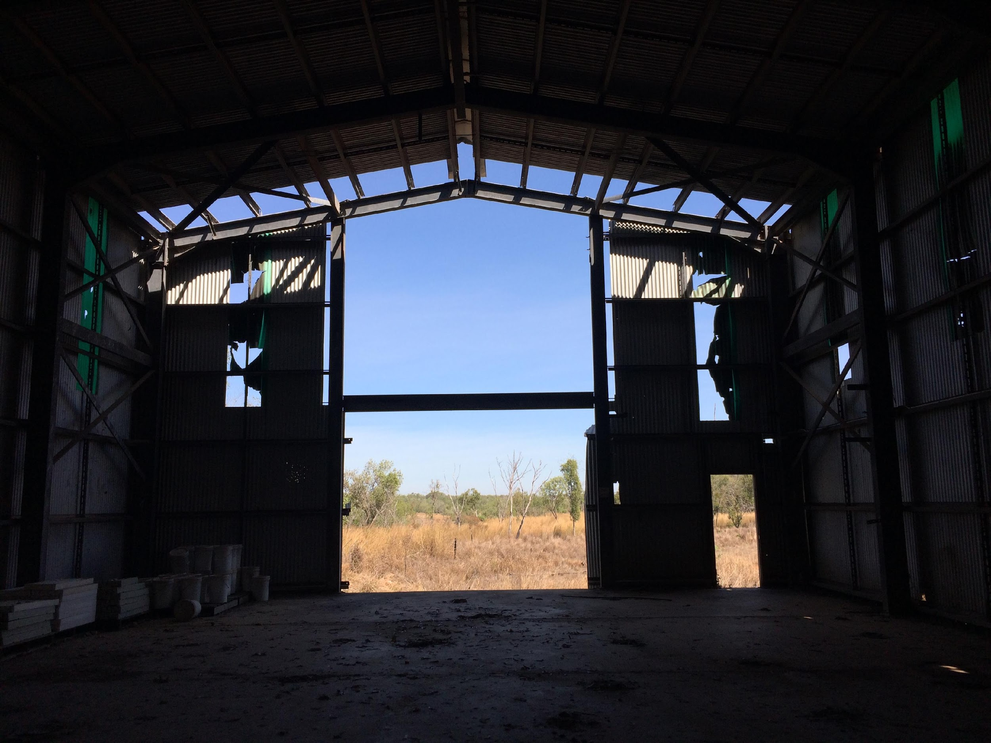
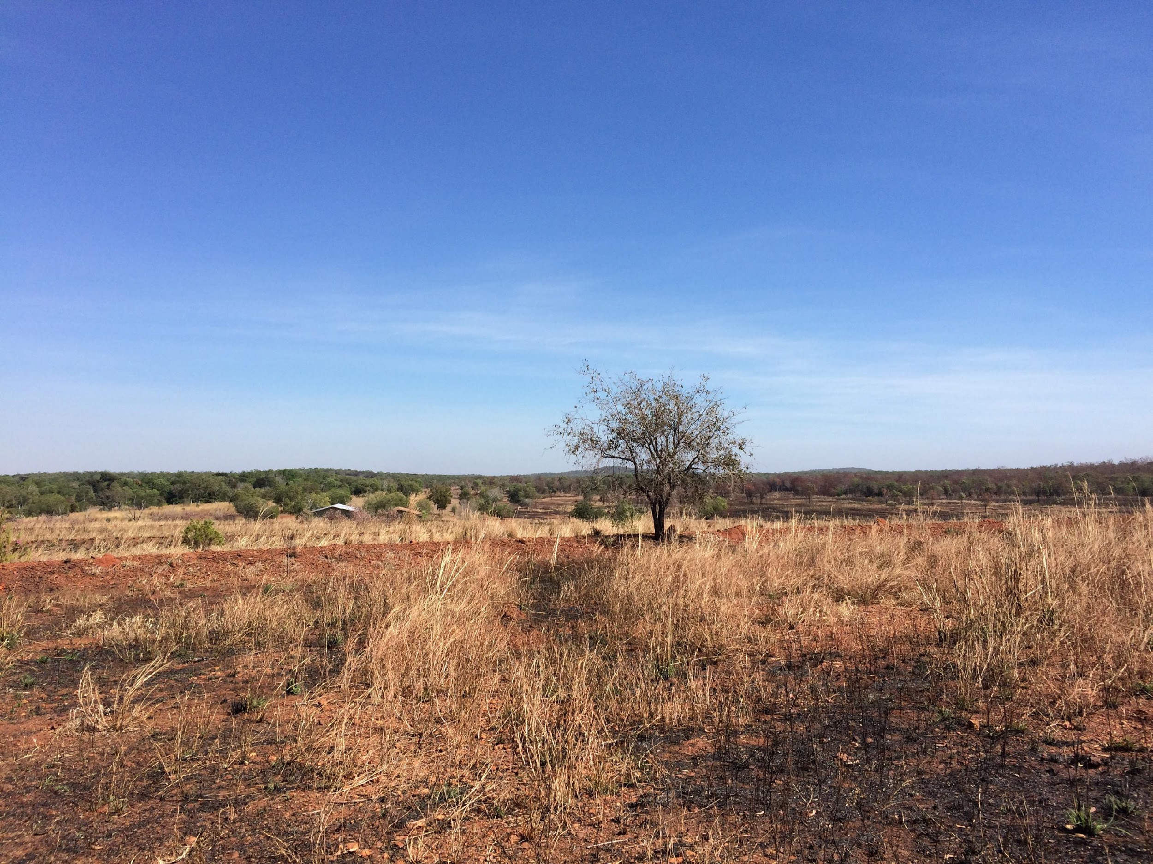
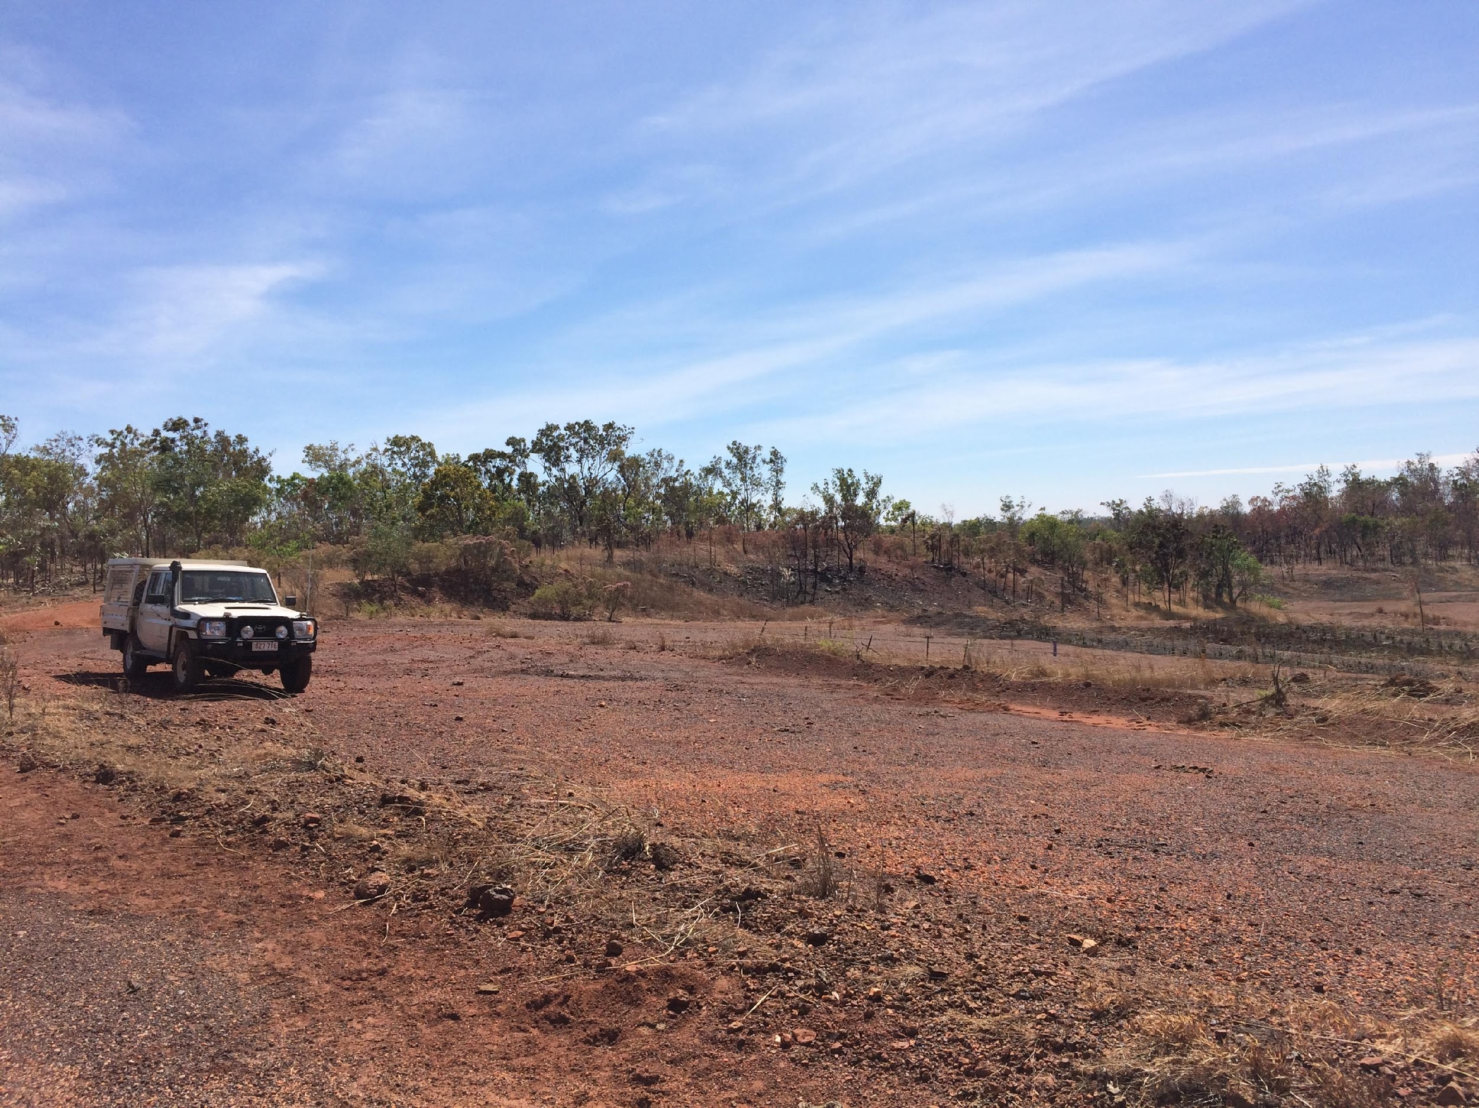
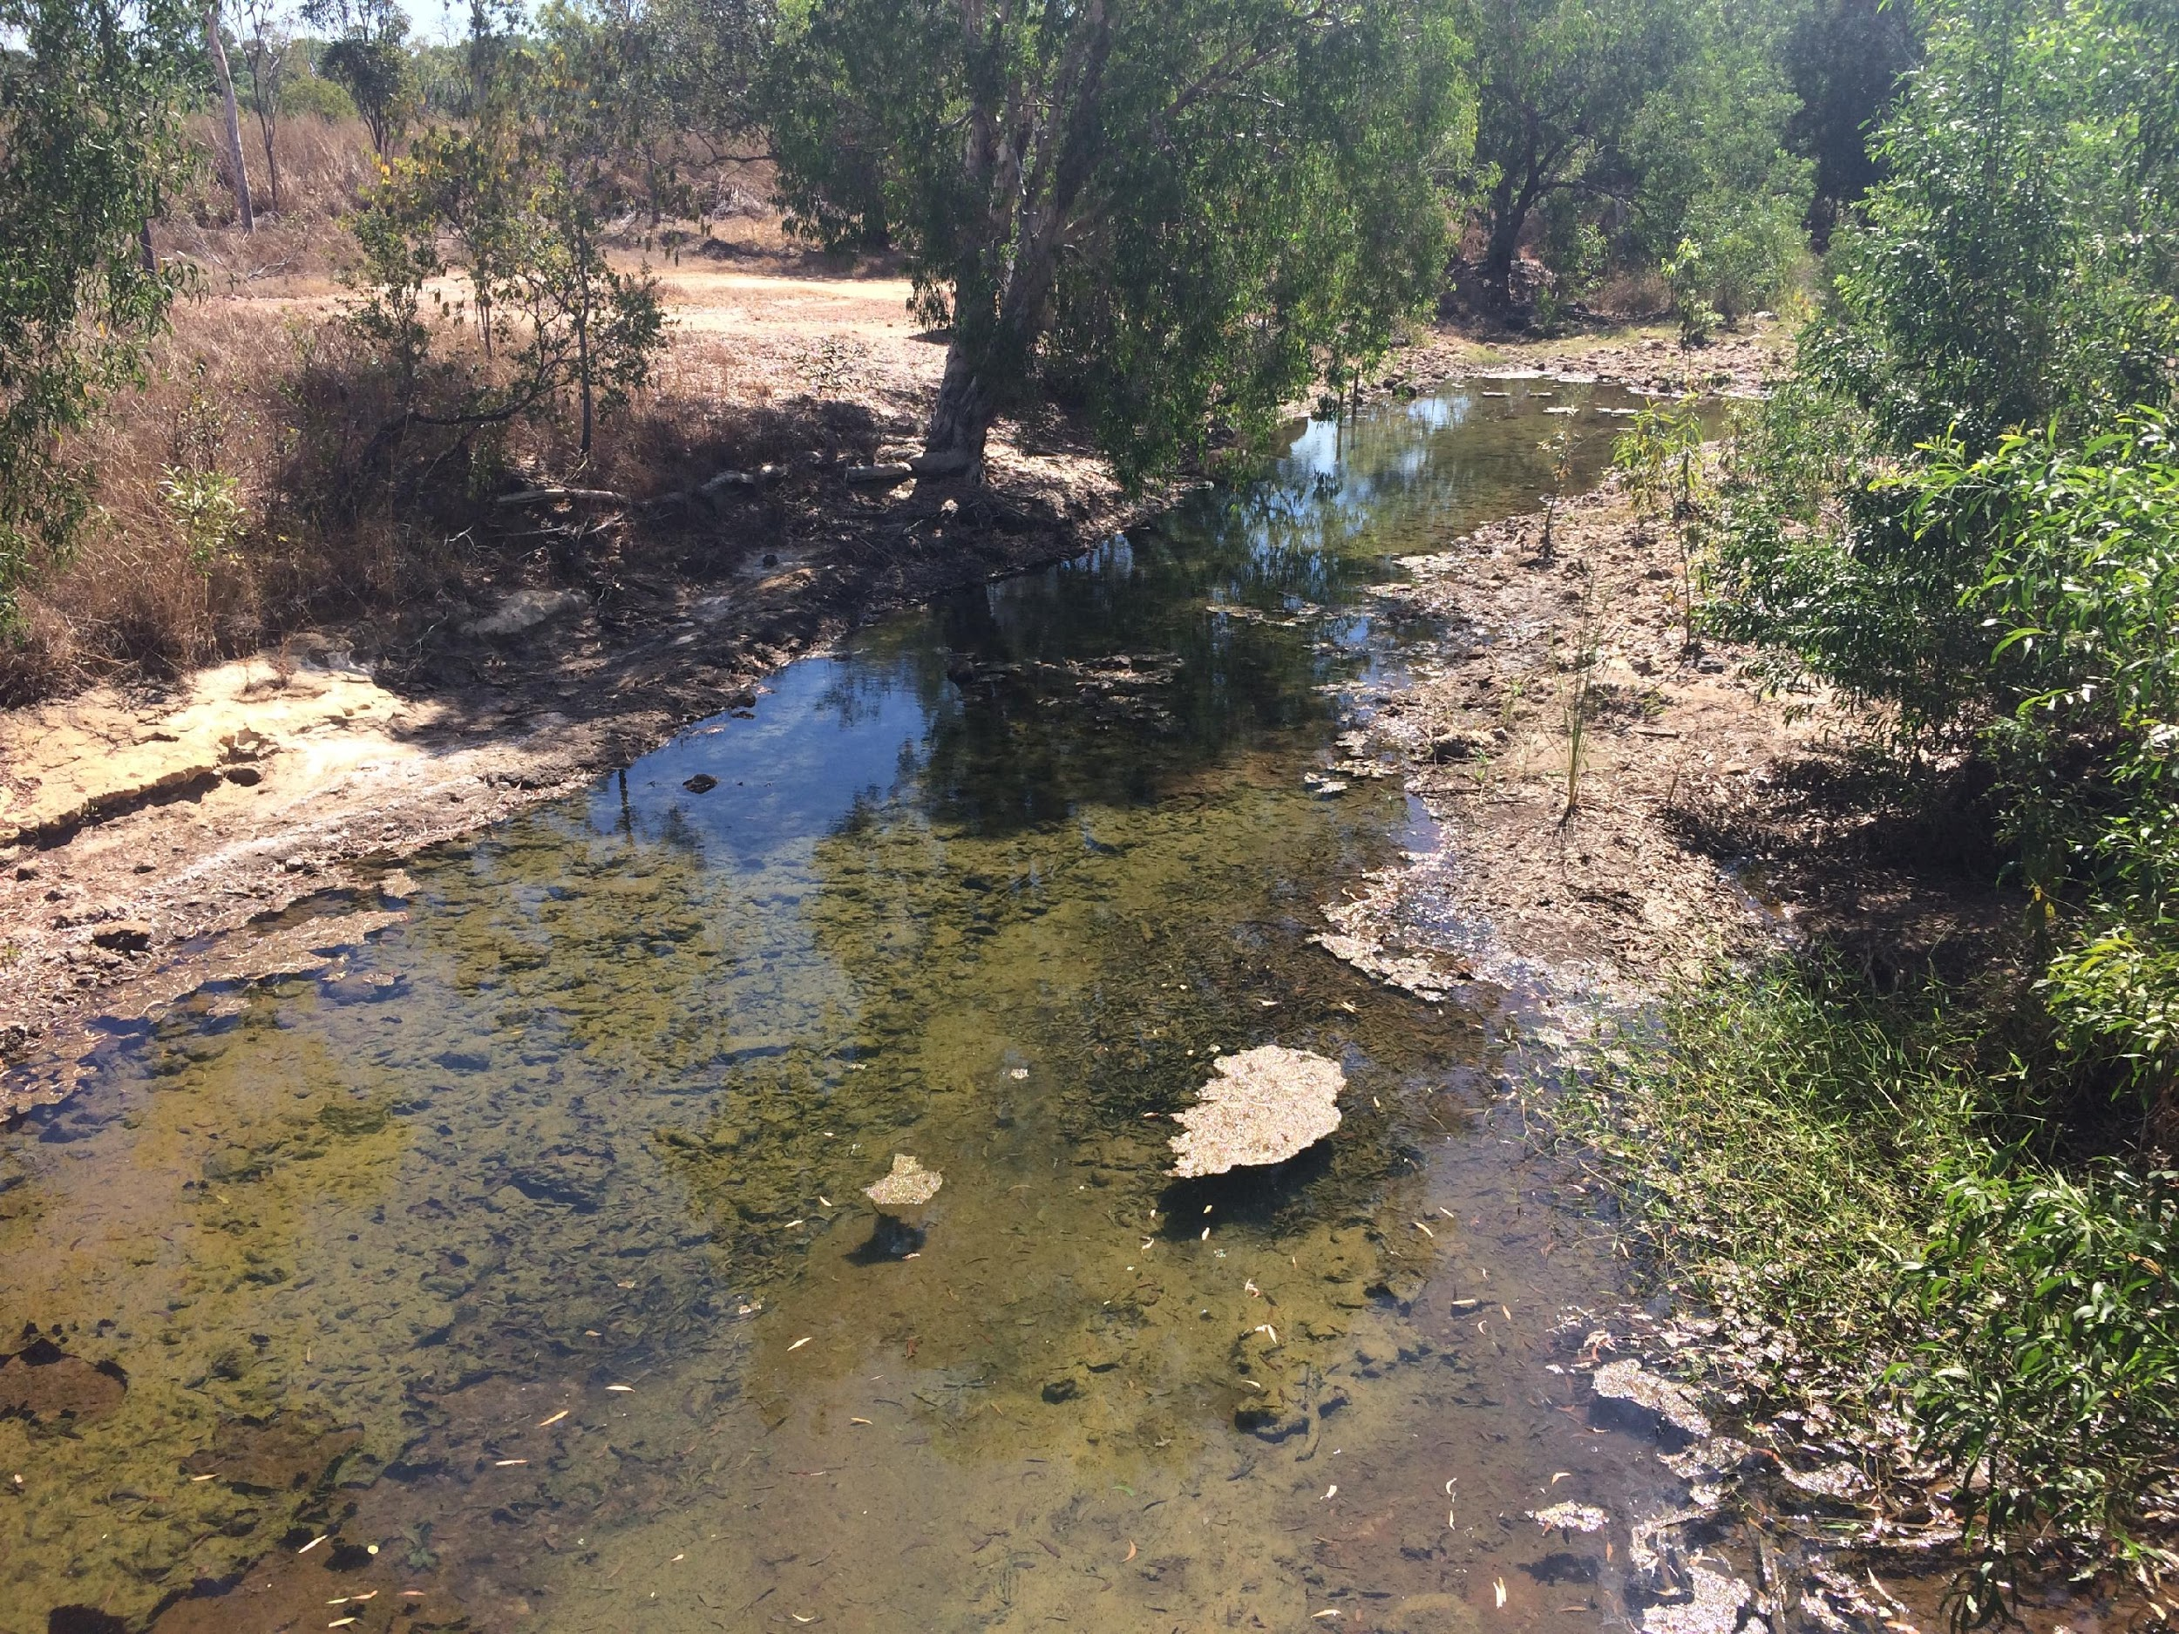
Notes:
I’ve included Rum Jungle as a salutary reminder that the environmental impacts of militarization extend beyond the use of military equipment to the processes that create it. These photos were taken in the last month.
Rum Jungle uranium mine was set up by the Commonwealth government in the early 50s at the behest of the joint American and British Combined Development Agency.
The Agency funded the development of the mine and purchased virtually all of the uranium for the purpose of making nuclear weapons.
Processing at the mine ceased in 1971. Some rehabilitation work was done during the 80s which stabilized the site to the standards of the day, including significantly reducing the metal loadings in the local river. Left unremedied were the catastrophic effects on the two sacred sites in the area – one of which is now the main pit of the mine.
Because of the remaining environmental damage, the site was not able to be returned to its traditional owners. For the last few years, the NT government has been funded by the Commonwealth government to work with the traditional owners, come up with a rehabilitation plan and carry out an environmental impact assessment process.
After that, they will prepare a detailed business case to the Commonwealth government who will decide whether to fund what will be a rehabilitation project running into the hundreds of millions.
More than half a century since the mine began, the cultural and environmental impacts continue.

Slide 4
Major Military Installations in the NT
Two air force bases:
RAAF Darwin and RAAF Tindal
Two army barracks:
Larrakeyah and Robertson
One naval base:
HMAS Coonawarra
Four onshore training areas:
Delamere Air Weapons Range,
Bradshaw, Kangaroo Flats,
Mt Bundey
One joint US/Australian signals installation: Pine Gap
Other Sites of Interest
One former mine that supplied uranium for the UK and US nuclear weapons program:
Rum Jungle
One proposed deep water port to accommodate the US Navy: Glyde Point
Notes:
Going back to the map, the signals installation at Pine Gap near Alice Springs is the southernmost point of US-Australian cooperation in the Northern Territory.
Even though its local environment is not being used as a detonation area for munitions, Pine Gap still has its environmental impacts.
Established in 1969, for most of its life, up until the early 2010s, all activity at Pine Gap was powered by diesel generators.
It was only in the early 2010s when it switched to natural gas…
Pine Gap has a right to extract 250 megalitres of water – the equivalent of 100 Olympic-sized swimming pools – from the confined aquifer that supplies Alice Springs from now until 2284 when the aquifer is set to run out.
Moving back to the joint force posture initiative, I’m going to spend most of my time talking about the proposed deep water port at Glyde Point (the green lightning bolt). But before I do, I will pause a moment on the training areas (the red rectangles). As you can see on this slide, there are four major on-shore training areas, all of which have been utilized for joint exercises. The next slide shows just how extensive some of these areas are.

Slide 5
Notes:
As you can see, the bootprint of these training areas is considerable, even in the context of the NT’s size.
The Delamere Air Weapons range (the green striped area labelled 2) is the main air weapons range used by the RAAF. The range is used for high explosive target practice using 500 pound to 2,000 pound explosives, as well as inert explosives and light weapons gunnery practice.
The Bradshaw Field Training Area, the pink area in the west of the NT, is approximately 900,000 hectares and has been used for a range of joint training exercises.
There is also an Air-to-Air Weapons Range off the coast of Darwin and an offshore training area.

Slide 6
Source: Dept. of Defence
Notes:
The Department of Defence carries out its own environmental assessments, focusing particularly on the matters of national importance in the EPBC Act.
For their large joint initiatives, they tend to prepare environmental reports to assess the environmental impact of their activities. Only if Defence deem that there will be a residual significant impact on the environment will they refer the matter to the Federal Environment Minister for approval under the EPBC Act.
The stated aim of Defence in their ER for Talisman Saber 2019 was that “there will be no significant impact to the environment and all reasonable measures to further reduce avoidable impacts will be incorporated”.
According to Defence, consultation and consideration of environmental impact is starting to occur earlier in the process.
Defence’s environmental management efforts are such that when DoD was undertaking a social and economic impact assessment process [last year in relation to the Joint Force Posture Initiative, 70% of a sample of Territory residents surveyed are not overly concerned about “negative impacts on the Bradshaw Field Training Area”. The phone survey was carried out on 408 Greater Darwin residents – it is unclear how much information they had about a 900,000 hectare block, 270 kms south west of Darwin, to which access is restricted.
So saying, “multiple stakeholders expressed a view that “Defence has better environmental controls than National Parks” and “The Northern Land Council specifically mentioned species monitoring, water quality and weed control programs at Bradshaw as positive examples of the ADF’s environmental impacts.”
As the 2013 Friends of the Earth Report “US Bases in Australia: the social and environmental risks” argues, there are a number of environmental impacts that Defence are unwilling to acknowledge:
Contamination (particularly cumulate contamination) from live firing and munitions.
Impacts of marine warfare, including sonar technology, on aquatic mammals.
We can add to this list greenhouse gas emissions contributing to climate change. While the public environmental reports prepared for the last two Talisman Saber exercises do not deny climate change, they do not accept responsibility for contributing to its risks:
In the TS 2017 report, they identify a risk that “Possibility that the action will increase atmospheric concentrations of gases which will contribute to the greenhouse effect or ozone damage.” but think that is is unlikely and say “Greenhouse gases would be produced as a result of the action; however, these would be insignificant in the context of Australia’s overall greenhouse gas emissions and are an unavoidable by-product of this crucial exercise to maintain and enhance ADF capability.”
In the TS 2019 report, they simply say that “TS19 involves no real chance or possibility that the exercise will: increase atmospheric concentrations of gases which will contribute to the greenhouse effect or ozone damage.”
There is considerable uncertainty as to the ADF’s total emissions as Friends of the Earth have identified.

Slide 7
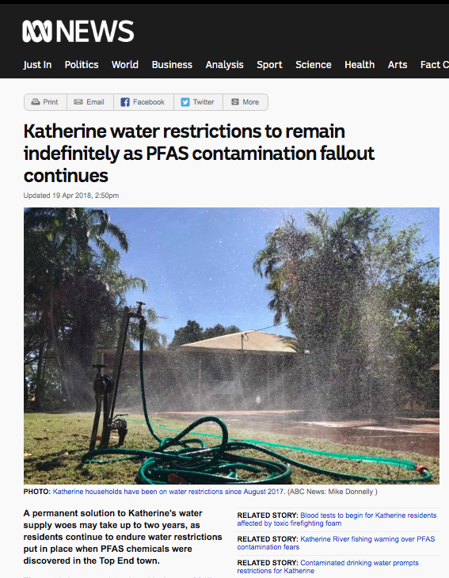
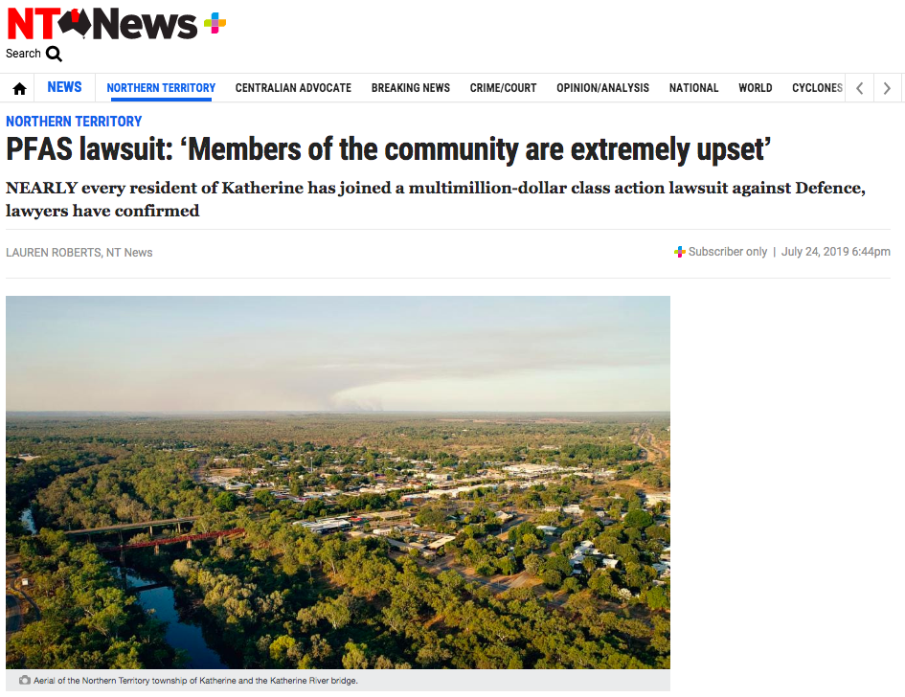
PFAS
Notes:
To reiterate the point that information about environmental contamination by the military is not transparent, I want to talk about one particular environmental impact that Territorians are concerned about.
As in other parts of Australia and the world, PFAS from defence bases has caused water contamination in the Territory.
As ABC News has reported, the Australian government was warned by the US government in 2000 that the firefighting foam it used contained "potentially pose a risk to human health". Defence did not phase out use of that foam until 2012 and did not start to tell people about possible contamination until 2015.
PFAS - Per- and poly-fluoroalkyl substances – are a class of synthetic chemicals widely used for their heat, oil, stain and water resistant qualities. One property that was particularly useful to the Defence Department was their ability to put out liquid fuel fires.
The Department of Defence has carried out investigations into contamination from three areas in the NT: two sites in Darwin - RAAF Darwin and Robertson Barracks, and RAAF Tindal, near Katherine.
Katherine’s drinking water supply was contaminated with PFAS. Defence has paid for a treatment plant to remedy drinking water contamination. The residents of Katherine have filed a class action law suit against the Department of Defence in relation to alleged land value reductions due to the contamination crisis.
In relation to the Robertson Barracks, there is PFAS contamination in the local stream which drains into a permanent swamp. The whole area is part of the Shoal Bay area of conservation significance. Effects on the aquatic ecosystems cannot be ruled out. Measures will be taken to discourage recreational fishing the stream.
In relation to RAAF Darwin, PFAS has contaminated Rapid Creek and Ludmilla Creek – measures are being taken to provide advice to residents about eating fish and crustaceans in those creeks.
The Expert Health Panel set up by the Australian Government concluded that “there is mostly limited or no evidence for any link with human disease from these observed differences. Importantly, there is no current evidence that supports a large impact on a person’s health as a result of high levels of PFAS exposure. However, the Panel noted that even though the evidence for PFAS exposure and links to health effects is very weak and inconsistent, important health effects for individuals exposed to PFAS cannot be ruled out based on the current evidence”

Slide 8
Big Plans for the Build-Up
“Approximately $2 billion is being invested to expand and upgrade Defence infrastructure and facilities in Northern Australia. Both the United States and Australian Governments have committed to a package of infrastructure and facilities works concentrated at Robertson Barracks, RAAF Base Darwin, RAAF Base Tindal and training areas across the Northern Territory. Subject to national and bilateral approvals, construction is expected to start in 2018-19 and continue through to the mid‑2020s. The United States and Australian Governments will fund required works separately.”
Regional Australia—A Stronger Economy Delivering Stronger Regions 2018–19 in Budget 2018-2019
Notes:
In addition to the already existing impacts of the Joint Force Posture Initiative, there are plans for extensive capital spending in Northern Australia, particularly at facilities in the Norther Territory.
As announced in the 2018/2019 Budget documents relating to Regional Australia - “Approximately $2 billion is being invested to expand and upgrade Defence infrastructure and facilities in Northern Australia. Both the United States and Australian Governments have committed to a package of infrastructure and facilities works concentrated at Robertson Barracks, RAAF Base Darwin, RAAF Base Tindal and training areas across the Northern Territory. Subject to national and bilateral approvals, construction is expected to start in 2018-19 and continue through to the mid‑2020s. The United States and Australian Governments will fund required works separately.”

Slide 9
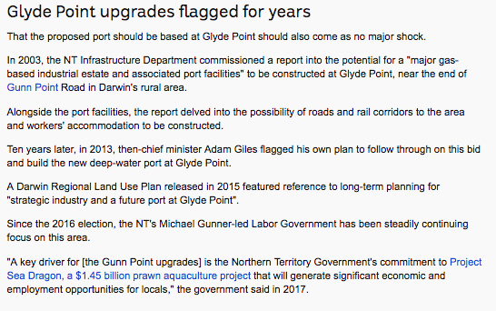
Notes:
In the last month, the ABC has reported that planning had begun on a new port facility near to Darwin, which could accommodate US warships. Apparently the development would be a commercial port rather than a military base.
ABC sources confirm that port development will be in the Glyde Point area. Any deep water port there would require dredging and substsntial constructions works, impacting terrestrial, coastal and marine ecosystems.
According to the ABC, “a recent draft US Congressional bill … reveals a total of $US211.5 million ($305.9 million) has been allocated for new "Navy Military Construction" in Darwin, but few other details are available.”
The draft Bill also contains provision for “$US50 million for a "new airport parking apron for the Navy", and $US70.6 million for the Air Force at Tindall”.
Glyde Point has been eyed for development multiple times over the last few decades and each time has been resisted by the Environment Centre NT and others because of the significant environmental values of the site.
In 2003, the NT Government proposed a port facility and heavy industry site, with accompanying residential development. That didn’t go ahead but the proposal for a deep water port was revived ten years later which again did not proceed.
We are very concerned that this time the proposal might succeed, if the weight of the Australian and US militaries are put behind it.

Slide 10
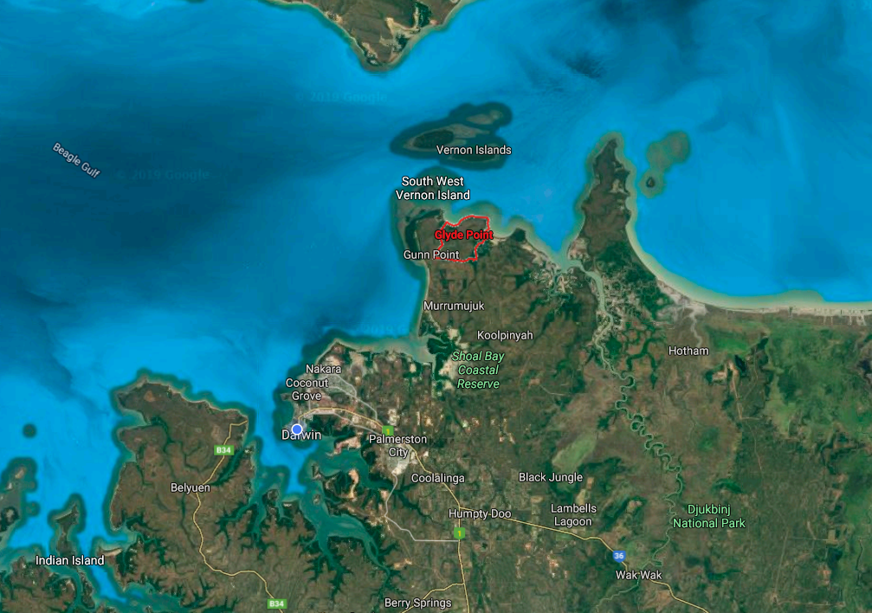
Notes:
Glyde Point is 40 kms northeast of Darwin (75kms by road), on the Gunn Peninsula.
The Vernon Islands lie just to the north of the site and would likely be impacted by construction works for the port and then increased marine traffic.
The Gunn Peninsula has been used by Larrakia people for hunting, teaching and ceremonial purposes both pre- and post-European contact. There are numerous registered sacred sites and there are native title claims over the Peninsula. The Larrakia acknowledge that the neighbouring Tiwi and Wulna people also have customary use of the area.
Darwin region residents use the Gunn Peninsula for recreational fishing and informal camping, as well as traditional hunting and teaching.

Slide 11
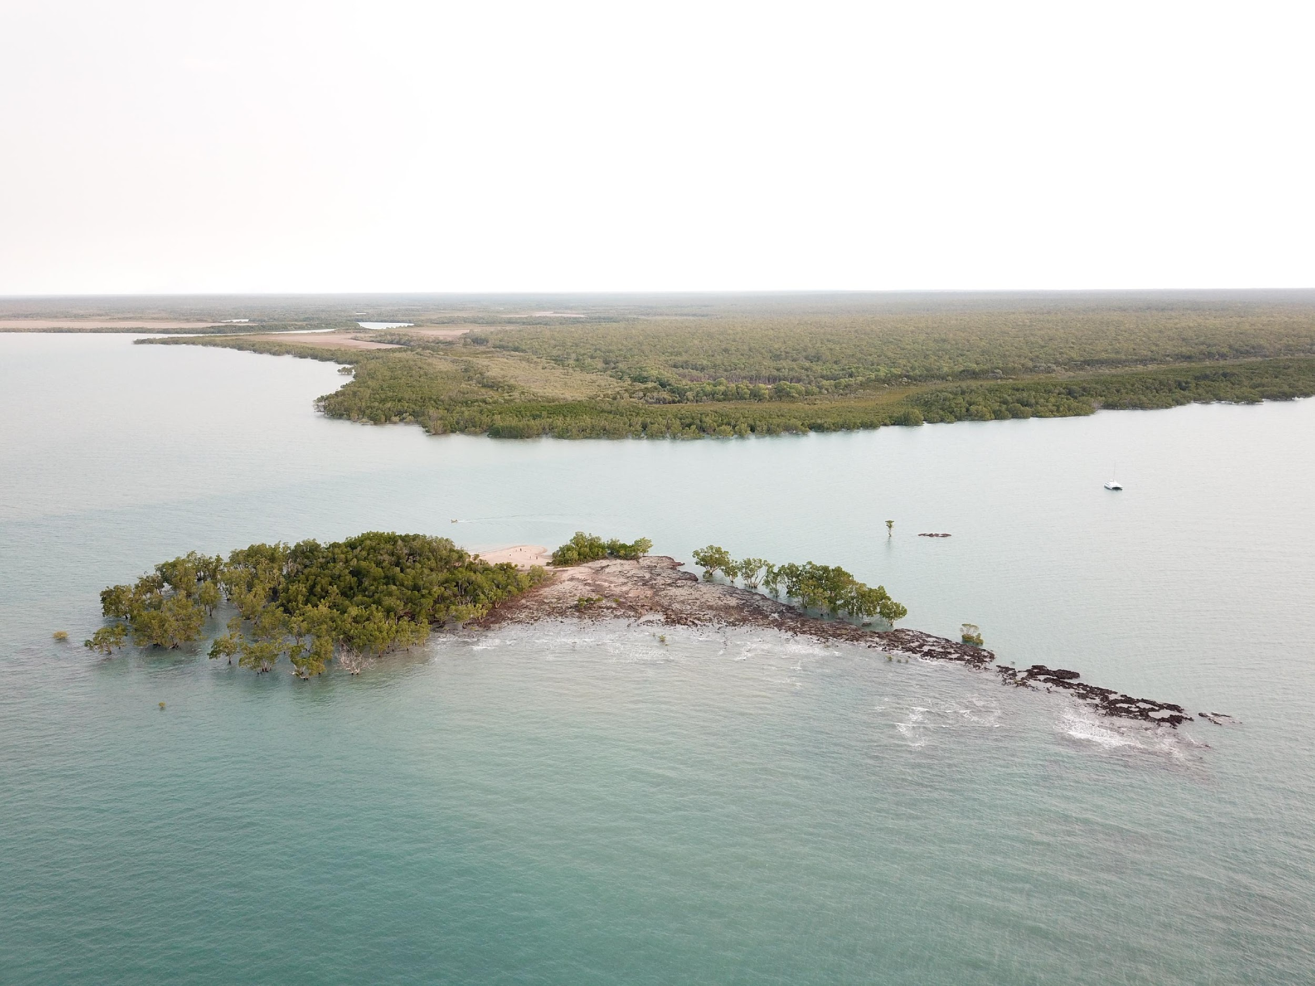
Notes:
The Glyde point area is low- lying – the entire peninsula does not rise about 45 m above sea level.

Slide 12
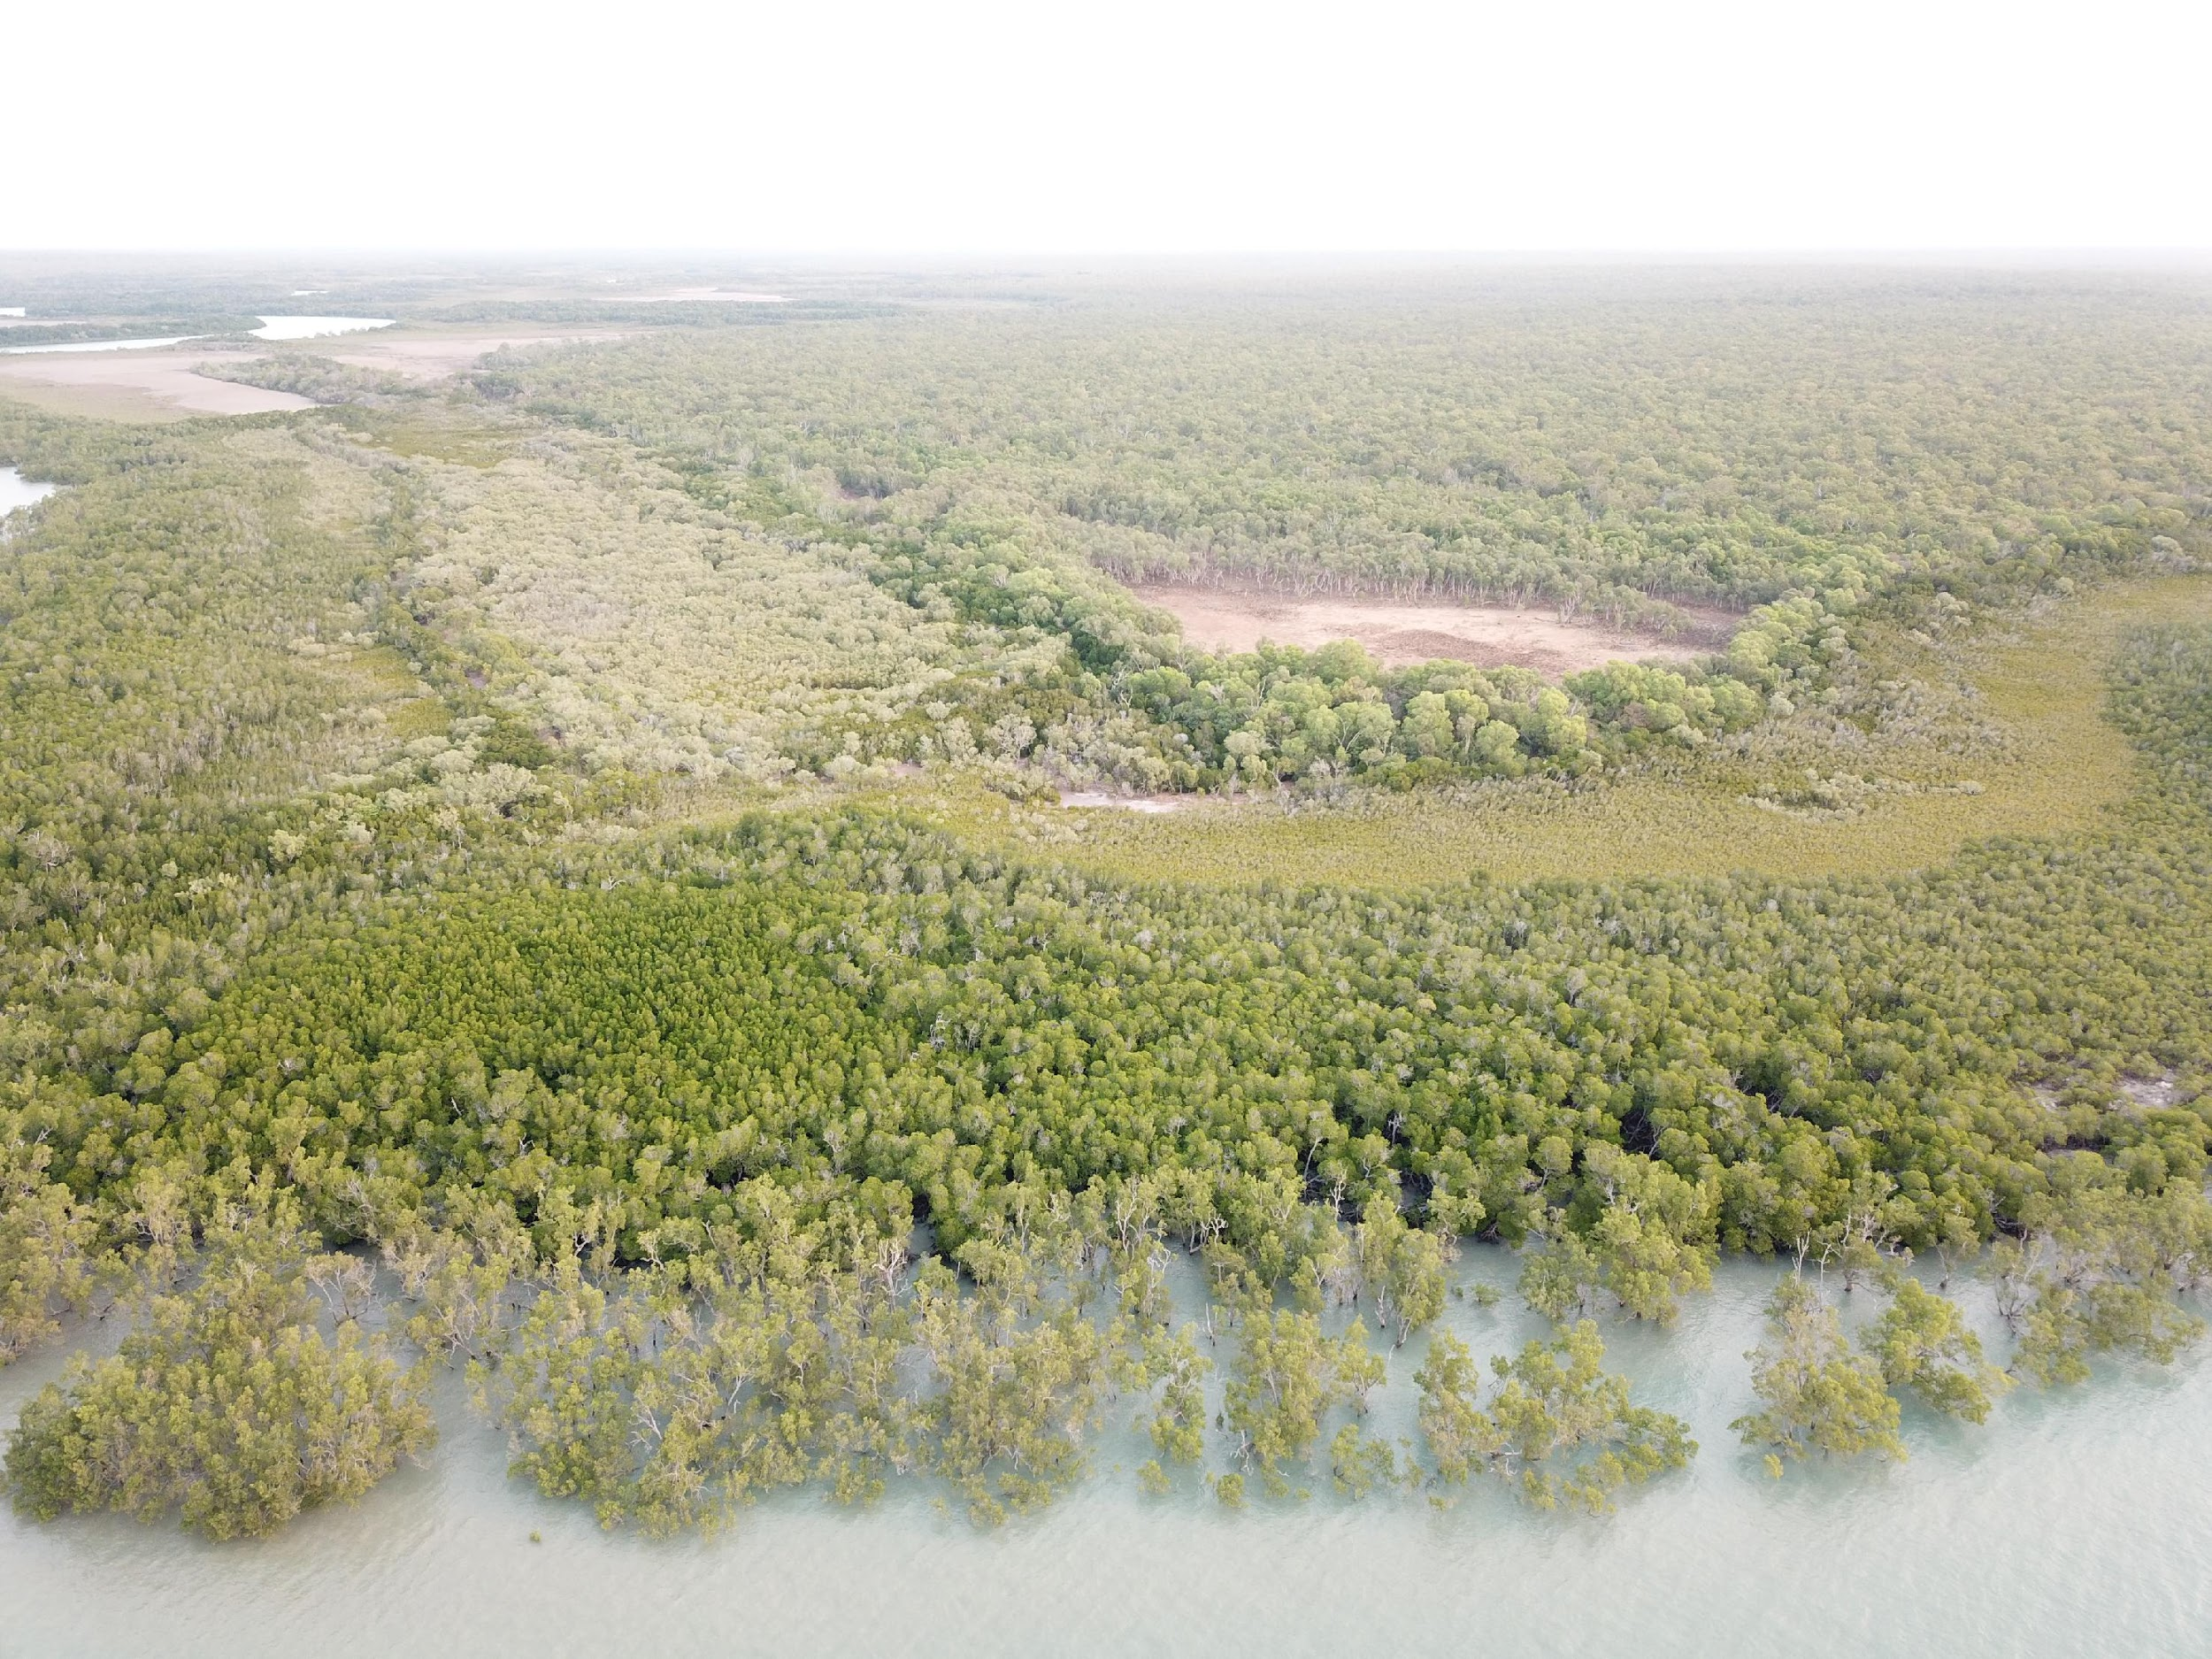
Notes:
There is a huge range of ecosystems in the Gunn Peninsula area, including reefs, mangroves, savanna woodlands, wetlands and rainforests.

Slide 13
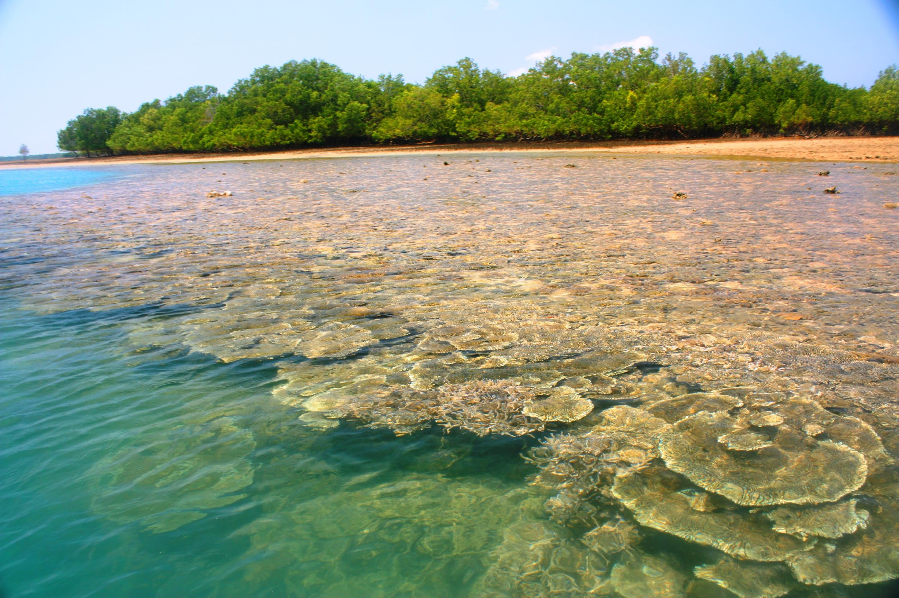
Notes:
[While there is little data about the reef communities off of the Vernon Islands] “it is generally accepted that the area is a highly significant marine community, with special habitats and higher species diversity than surrounding areas”.
The anemone fish (Amphiprion spp.) is found on the Vernon Island’s coral reefs and is endemic to the Northern Territory.
Hawksbill turtles, Green turtles, dugongs and a number of cetaceans are seen regularly in the area and the coastline of the Gunn Peninsula has been identified as an important turtle nesting area.
The number of corals and molluscs have been noted to be higher in the Vernon Islands area than Darwin Harbour, and more similar to the reefs found in the Garig Gunak Barlu National Park. The South West Vernon Island reef slopes support up to 75% cover of hard corals, which is rare in near shore northern coastal waters (CCNT nd.).

Slide 14
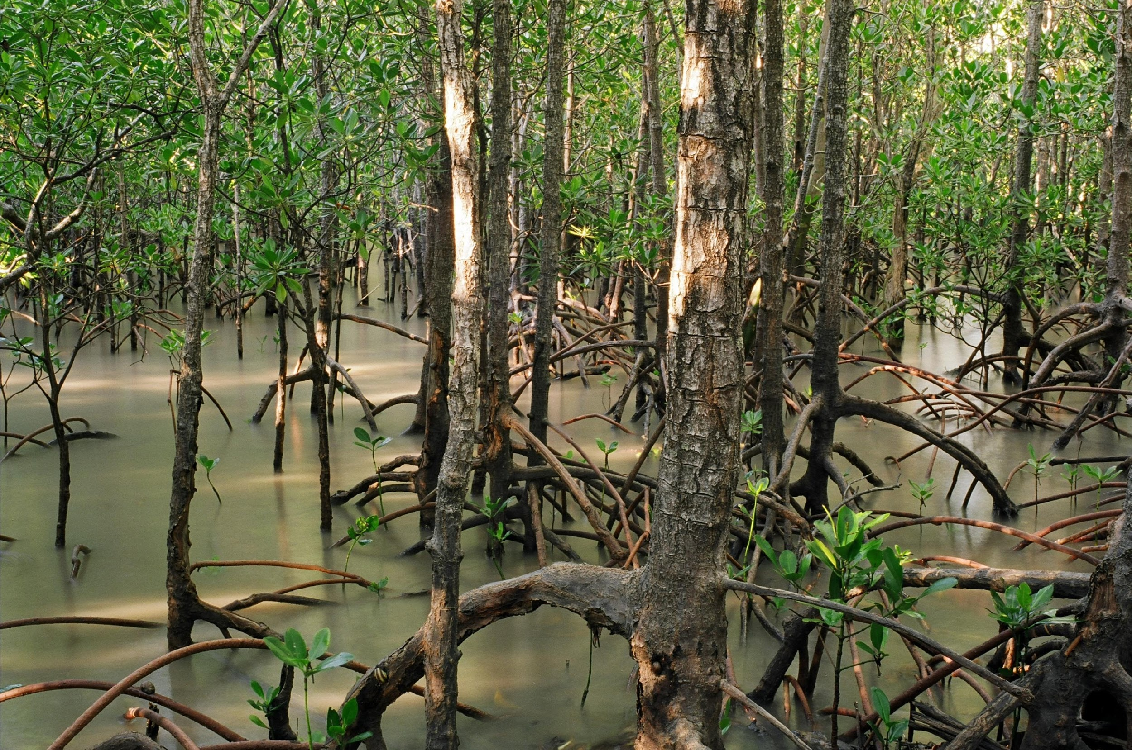
Notes:
Mangroves fringe the Glyde Point area.
Mangroves play a crucial role in maintaining biodiversity as many marine and terrestrial fauna are dependent on them.
They are one of the most productive natural systems in the world.
The destruction of mangroves consequently leads to a lower productivity of marine life, including fish, and deterioration of water quality (DEH 2001).
Mangroves also protect the coastal zone through acting as a buffer against cyclones, storm surges, flooding and coastal erosion

Slide 15
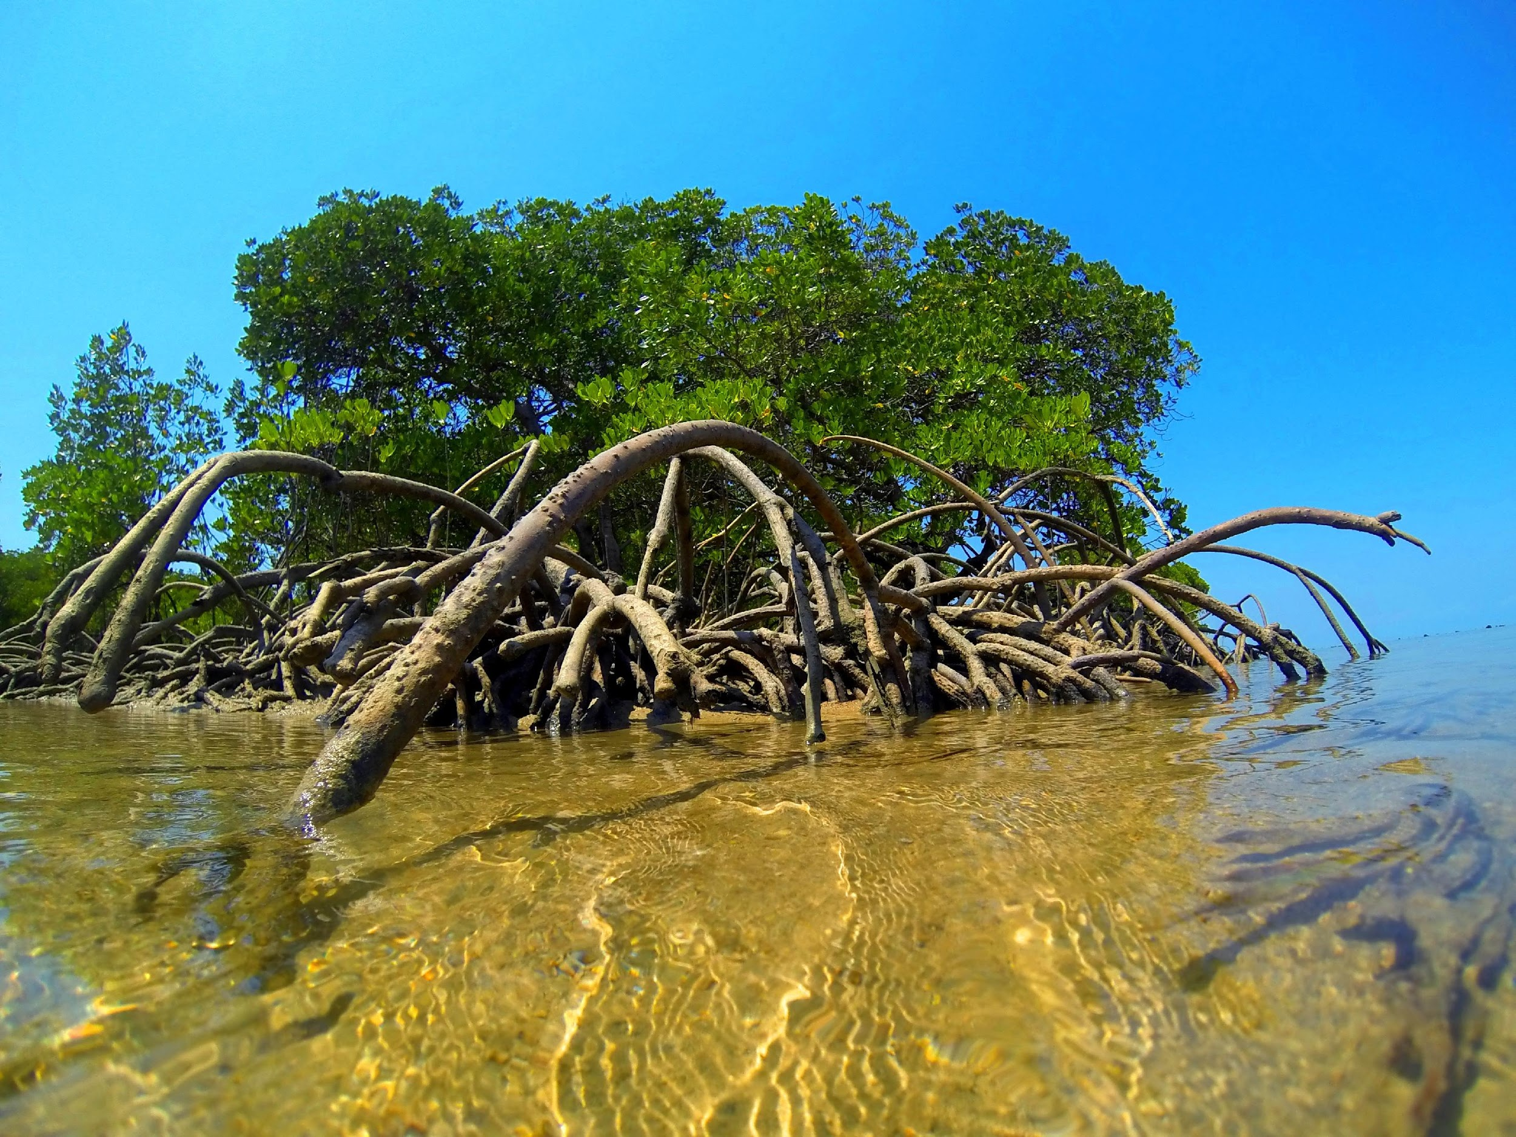
Notes:
The close proximity of coral reefs and mangroves found at the north west tip of Gunn Peninsula is likely to enhance the biodiversity of the marine life in the area.
Studies elsewhere have shown that the connectivity between coral reefs and mangroves greatly enhance the presence of reef fishes.
The most likely explanation for mangroves enhancing the fish biomass on nearby reefs is through provision of a refuge from predators and plentiful food that increases the survival of juveniles

Slide 16
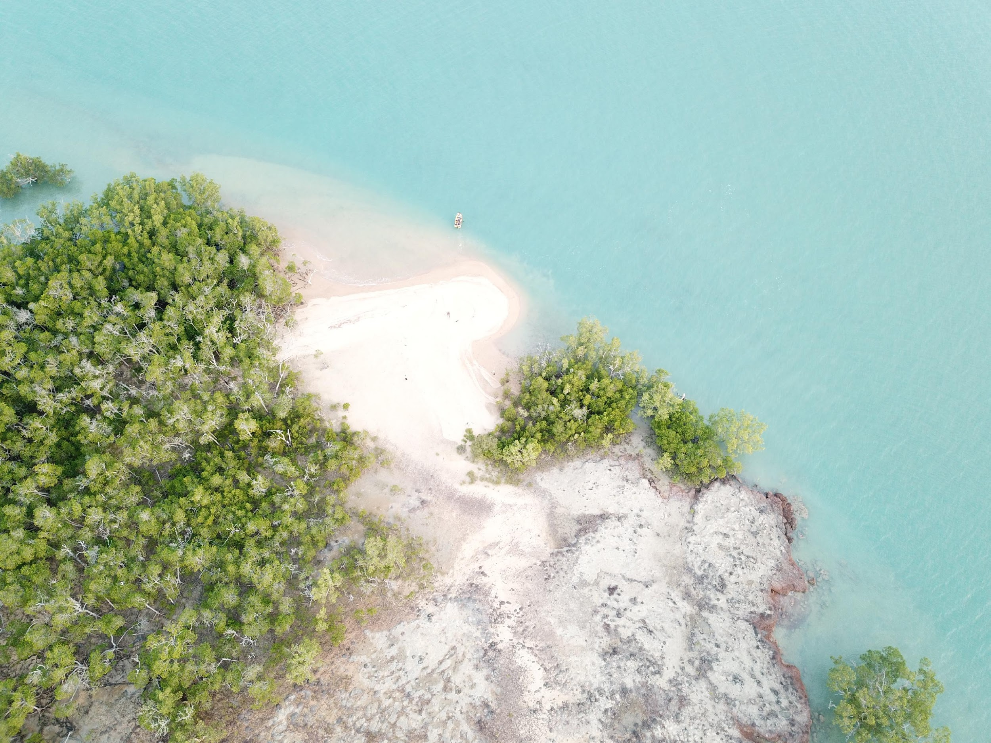
Notes:
The Peninsula also contains important chenier dune systems. These rare dunes are formed parallel to the shore and are made of deposited materials overlying estuarine mud
[Shar I don’t know if this is actually a picture of that dune system…]

Slide 17
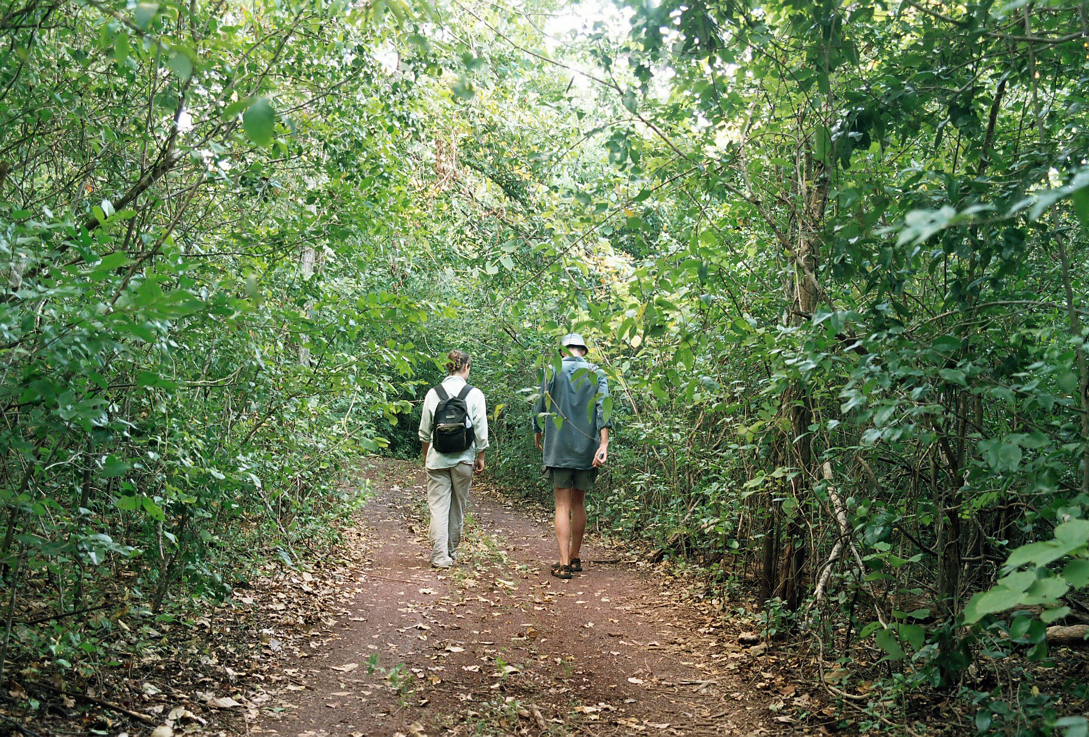
Notes:
When last assessed [in the 2006 report], there were 4 significant patches of unprotected monsoonal rainforest in the Gunn Peninsula area.
Rainforests are ecologically important in the Top End as they tend to support “because the proportion of species that depend on the rainforests is much greater than the proportion of the landscape the rainforests occupy”
Rainforest occurs as patches throughout the Darwin Coastal bioregion. The ecological integrity of the patches is dependent on the integrity of that patch network. Destruction of patches can threaten the integrity of other patches.
The rainforest patches are floristically diverse.

Slide 18
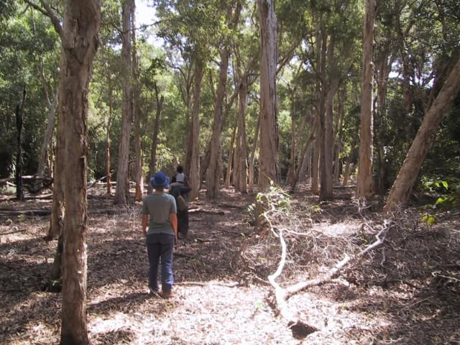
Notes:
The eucalypt woodland that dominates the inland of Gunn Peninsula is part of the northern Australian tropical savannas, the most extensive area of largely intact eucalypt habitat in the world (Woinarski et al. 2000b).
The woollybutt (Eucalyptus miniata) and ironbark (E. tetradonta) woodland provides an essential supplementary food source for rainforest fruit eating birds and bats during the dry season (Price et al. 2005), as well as a range of finches, parrots and pigeons that forage on the abundant seeding grasses in the savanna.

Slide 19
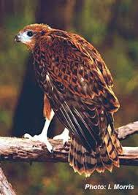
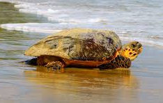
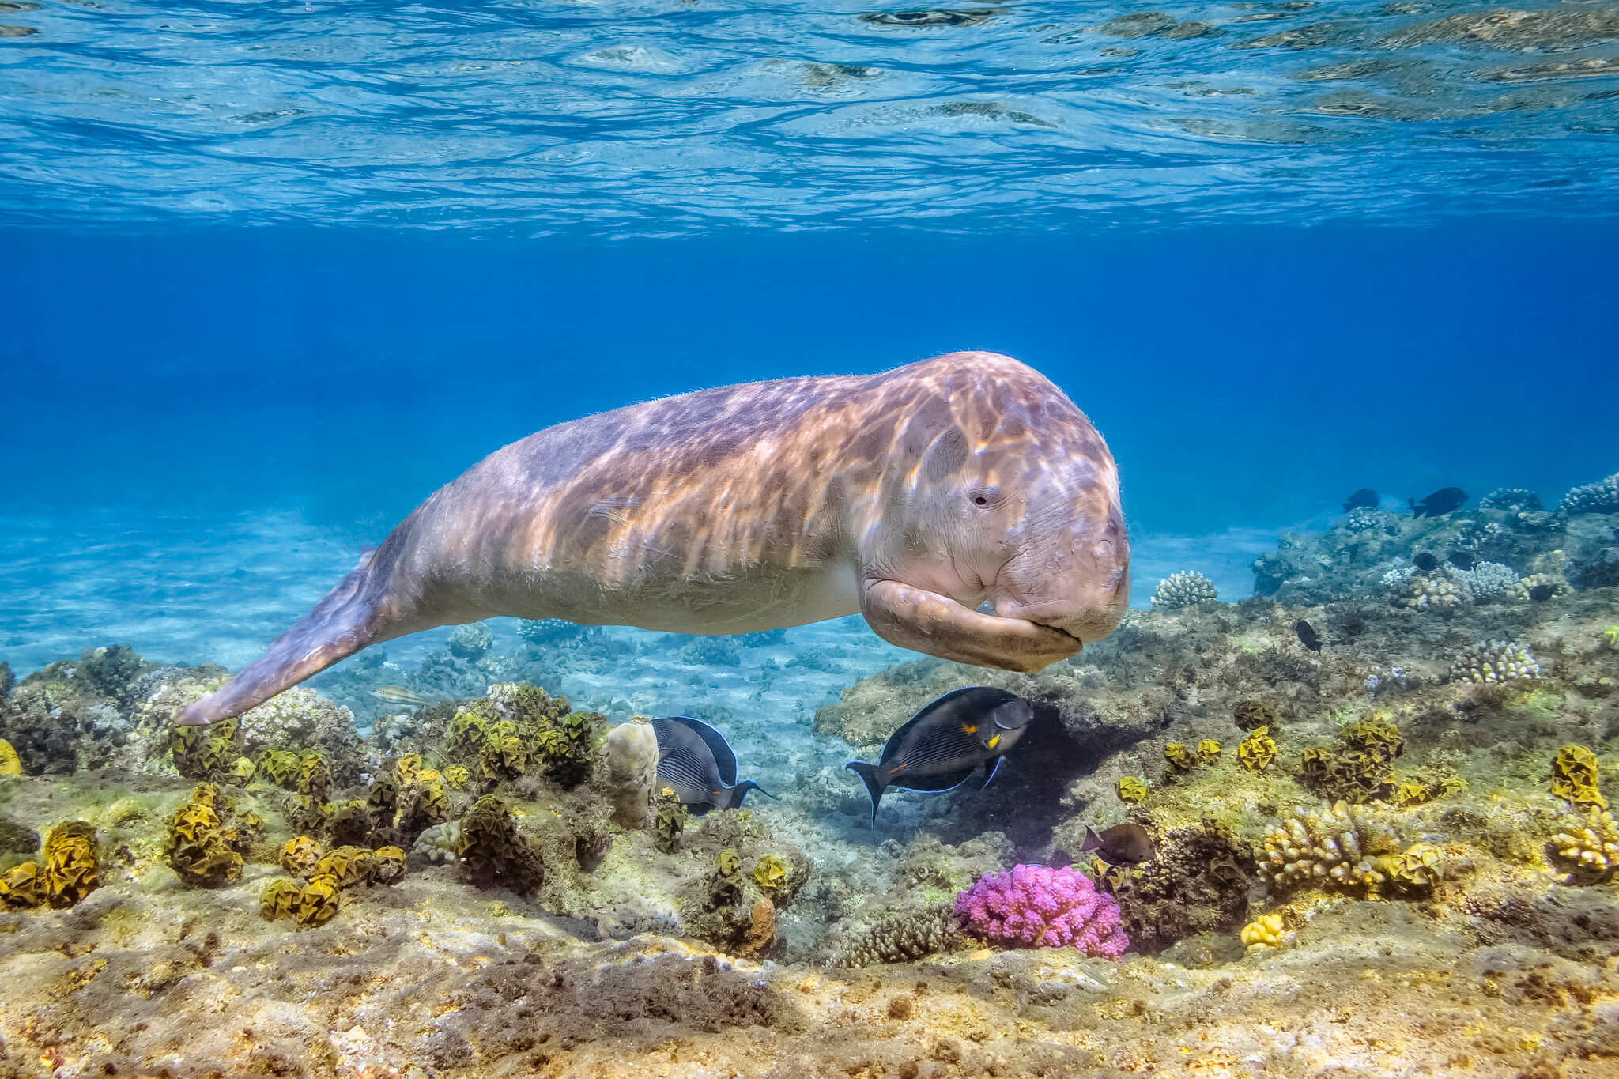
Notes:
[Also I found this photo of the red goshawk on an NT fact sheet, the hawksbill turtle from IUCN and the dugong photo from AMCS]
- When last comprehensivelt assessed, over 60 fauna species of conservation concern are found within the surroundings of the Glyde Point area, including threatened species, migratory species and marine turtles and mammals:
5 Endangered species.
10 Vulnerable species.
2 Near Threatened species.
15 Migratory species.
The IUCN listed critically endangered Hawksbill turtle is found in the waters adjacent to Glyde Point, as are the vulnerable dugong.
- Another vulnerable species is the red goshawk is a powerful bird of prey that feeds on birds and reptiles. A red goshawk nest has been located on the Gunn Peninsula in the past (GHD 2005) with the territory size of each breeding pair being about 150 km2 (Garnett and Crowley 2000). This species is listed as vulnerable in the NT.

Slide 20
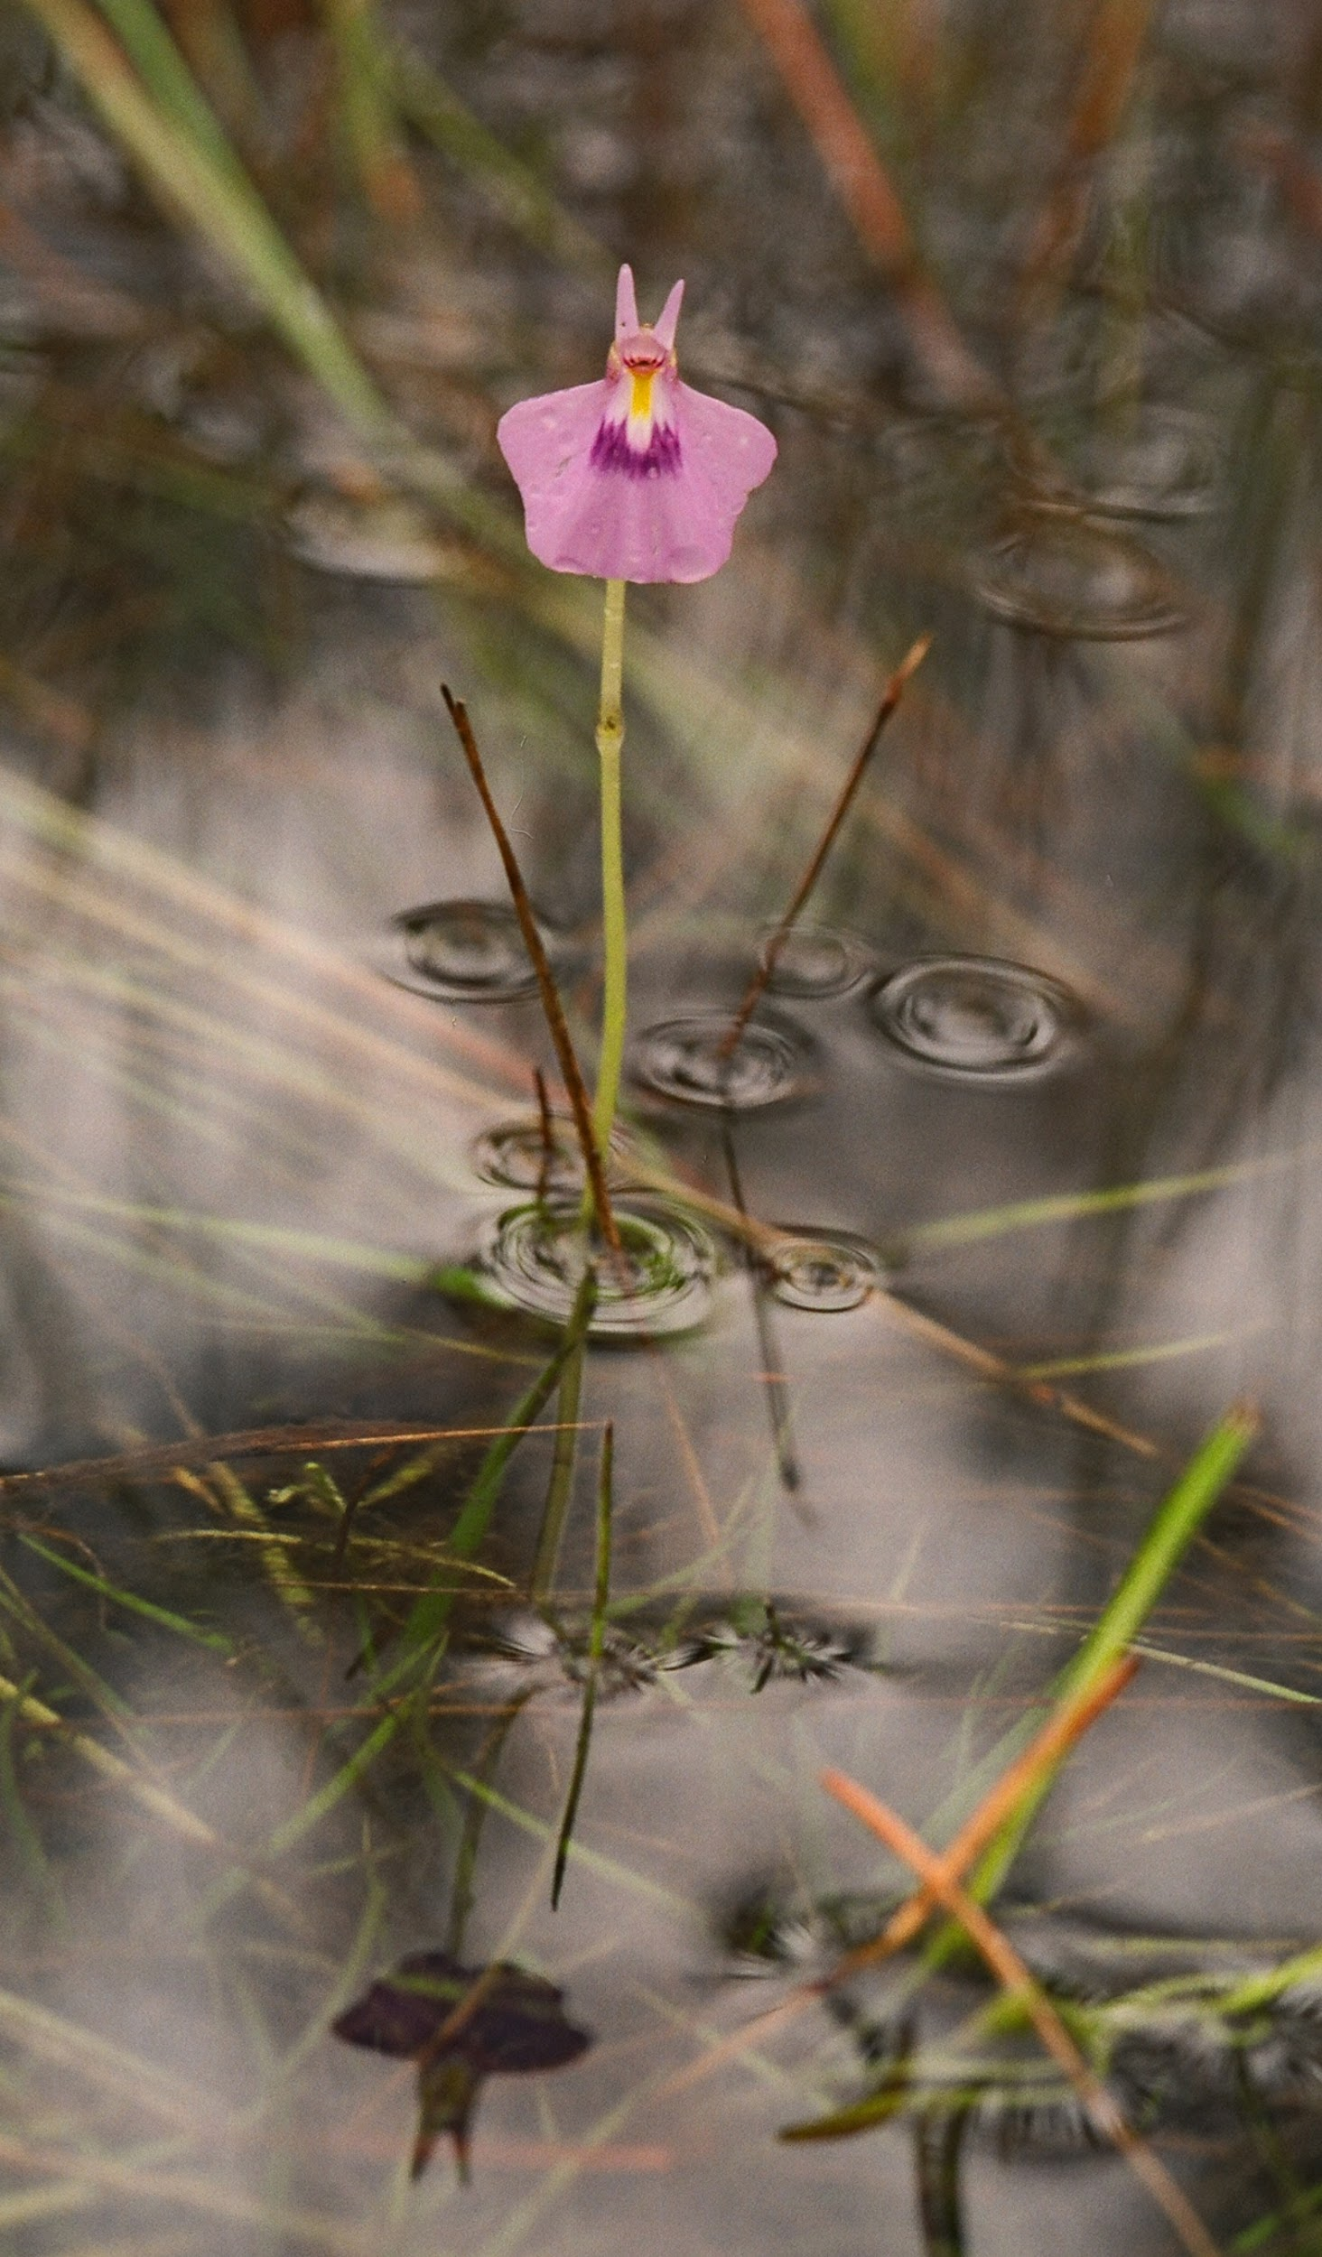
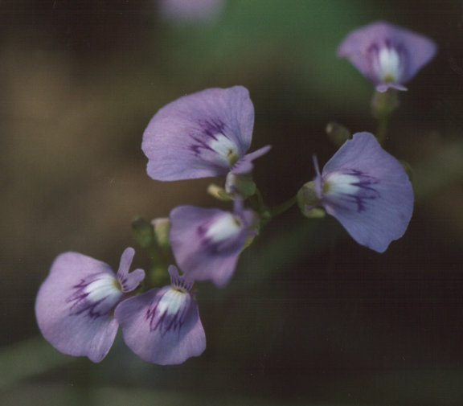
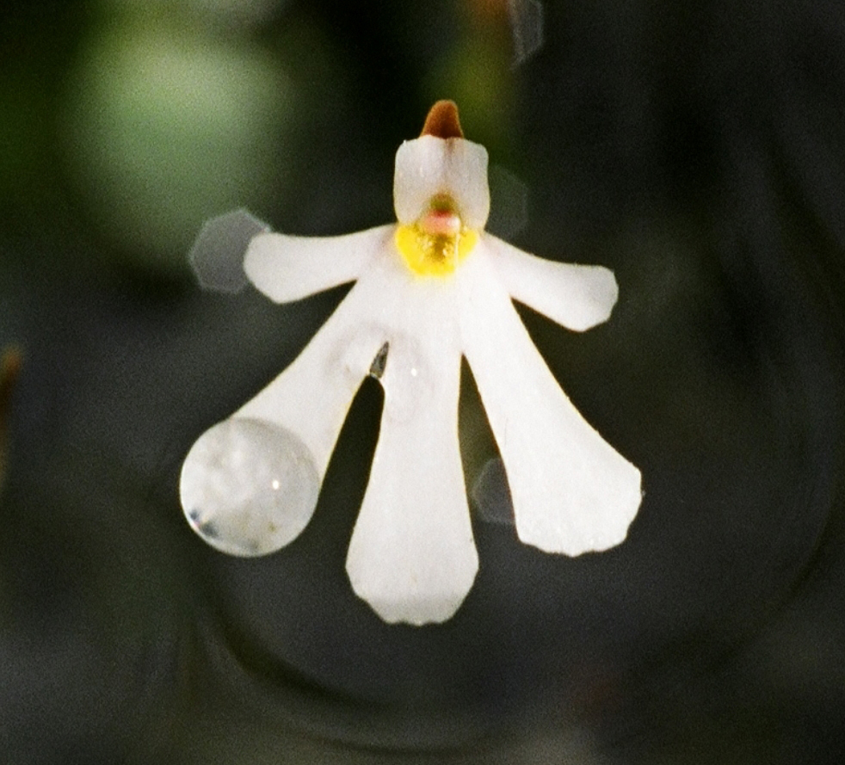
Utricularia hamiltonii
Utricularia triflora
Utricularia holtzii
Notes:
Moving from the charismatic megafauna to the threatened plants… We don’t know the scope of the proposal yet but if it has a similar footprint as previous plans, it will impact the habitat of plants these small bladderworts that are endemic to the NT. They occur as scattered individuals, and are restricted in their range across the Northern Territory.
Most of these bladerworts populations have been found in the Howard River floodplains, and the three species pictured are endemic to the Northern Territory.
A number of species have ”Near Threatened” status in the NT.

Slide 21
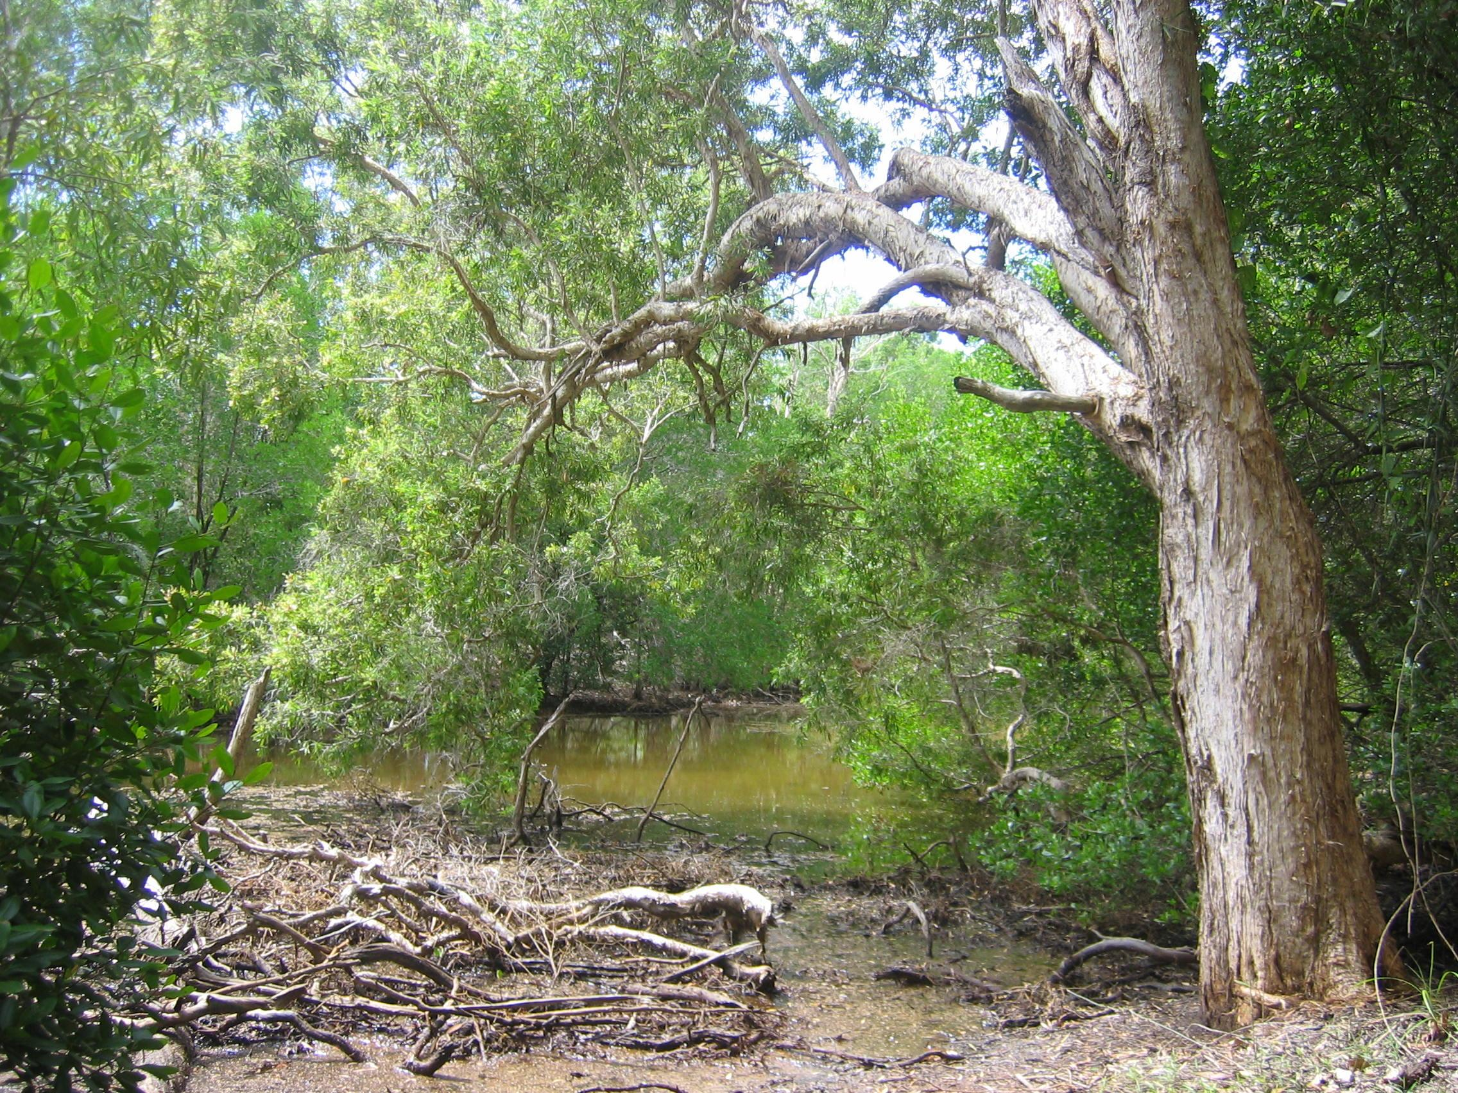
Notes:
Concluding thoughts
The Northern Territory has felt the impacts of US-Australia cooperation for decades before the Joint Force Posture Initiative but those impacts are set to ramp up with the proposed $2 billion of spending.
Local people (or at least the survey sample) may not concerned about some of the environmental impacts of the military in the NT. However, it is questionable how much can we really know about the impacts, particularly when activities take place in vast out of the way places that are not accessible to the public? As discussed, the military is not always willing to acknowledge some environmental issues. PFAS as illustrative example of the military delaying in telling people about contamination.
We are particularly concerned about the Glyde Point proposal.
Glyde Point’s fate has hovered between being set aside for its conservation significance or being developed for a few decades now. With the added impetus of “national” and “regional security”, this might be the excuse need to push this project through despite the environmental harms.
Again – who knows if we would even be able to quantify those concerns; will there be restrictions on what is released for security reasons?

